Slide 1

Exploring an Infinite Space using a few Weak Robots
Stéphane Devismes

Slide 2


Joint Work
Pascal Lafourcade
LIMOS, Univ. Clermont Auvergne
Quentin Bramas
ICUBE, Univ. Strasbourg

Slide 3
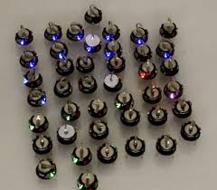
Question(s)
How a very few very weak robots can collaborate to solve an infinite task?
How robot skills influence the task resolution?
Case Study: Exploration of an infinite space by a swarm of mobiles robots

Slide 4
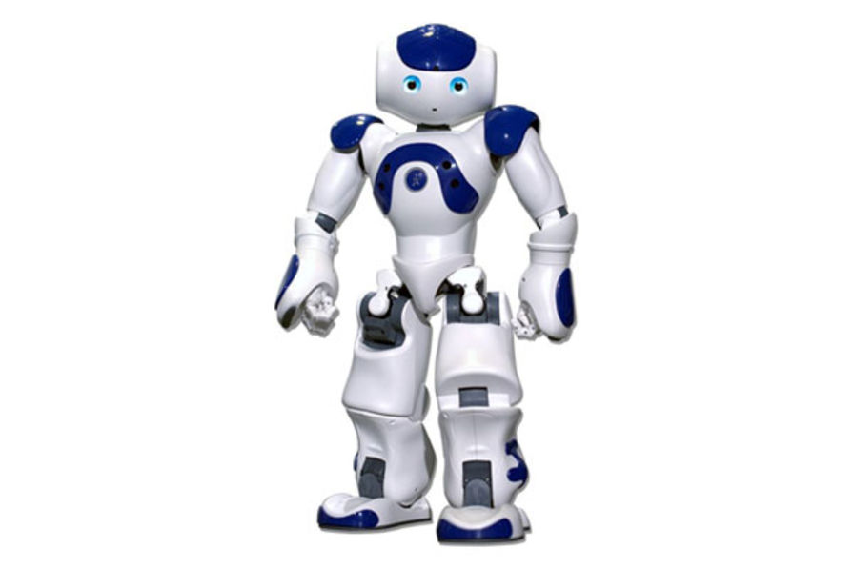
A finite number of robots in an infinite space

Slide 5
Exploring an infinite space

Slide 6
Exploring a discrete infinite space: an anonymous grid

Slide 7
Exploring a discrete infinite space: an anonymous grid

Slide 8
Robot skills: lights [Peleg, IWDC, 2005]
Each robot has a light with a constant number colors
(one color = oblivious)

Slide 9
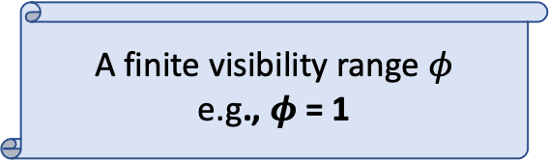
Robot skills: visibility
A finite visibility range $φ$
e.g., $φ$ = 1

Slide 10
Robot skills: visibility
A finite visibility range $φ$
e.g., $φ$ = 1

Slide 11
Robot skills: mobile

Slide 12
Robot skills: mobile

Slide 13
Robot skills: mobile

Slide 14
Robot skills: mobile
However, exclusiveness:
No two robots are simultaneously at the same place
No two robots traverse the same edge simultaneously

Slide 15
Robot skills: no compass

Slide 16
Robot skills: may have a common chirality

Slide 17


Robot skills: may have a common chirality
$$π/2$$
$$−π/2$$
We will study the impact of the common chirality on the task resolution

Slide 18
Other weaknesses
No additional persistent memory
No direct communication mean (deaf mute)
No whiteboard on nodes
No peeble …

Slide 19
Execution Model [Suzuki & Yamashita, SIAM Jrnl of Comp., 1999]
Look-Compute-Move Cycles

Slide 20
Execution Model [Suzuki & Yamashita, SIAM Jrnl of Comp., 1999]
Look-Compute-Move Cycles (here at distance 1)

Slide 21
Execution Model [Suzuki & Yamashita, SIAM Jrnl of Comp., 1999]
Look-Compute-Move Cycles (destination + color)

Slide 22
Execution Model [Suzuki & Yamashita, SIAM Jrnl of Comp., 1999]
Look-Compute-Move Cycles

Slide 23
Execution Model [Suzuki & Yamashita, SIAM Jrnl of Comp., 1999]
Look-Compute-Move Cycles

Slide 24

Rules and Chirality
=
=
=
$$≠$$
=
=
=

Slide 25


Rules and Chirality

Slide 26
Rules without Chirality
=
=
=

Slide 27
Rules without Chirality

Slide 28
Synchrony Refinements
Asynchronous
Semi-Synchronous
Synchronous
L | C |  | M |  | L |  | C | M | L |  | C
 |  | L |  | C | M | L | C | M |  | L
L | C | M |  |  |  | L | C | M | L | C | M
L | C | M | L | C | M | L | C | M
L | C | M | L | C | M | L | C | M | L | C | M
L | C | M | L | C | M | L | C | M | L | C | M

Slide 29
Synchrony Refinements
Asynchronous
Semi-Synchronous
Synchronous
L | C |  | M |  | L |  | C | M | L |  | C
 |  | L |  | C | M | L | C | M |  | L
L | C | M |  |  |  | L | C | M | L | C | M
L | C | M | L | C | M | L | C | M
L | C | M | L | C | M | L | C | M | L | C | M
L | C | M | L | C | M | L | C | M | L | C | M

Slide 30

Infinite Grid Exploration Problem
Predefined initial configuration
Each node of the grid should be visited by a robot within finite time:
  Let n₁, n₂, … the infinite sequence of nodes
  $∀ i≥1, ∃ k∈ℕ$*, n_{i} is occupied by a robot at time k

Slide 31
Overview of the results
With Chirality |  |  | Without Chirality
Number of robots | Visibility range | Number of colors | Number of robots | Visibility range | Number of colors
5 (opt) | 1 (opt) | 5 | 6 | 1 (opt) | 3 (oblivious impossible)
7 | 2 | 1 (opt, oblivious) | 8 | 2 | 1 (opt, oblivious)

Slide 32
Overview of the results
With Chirality |  |  | Without Chirality
Number of robots | Visibility range | Number of colors | Number of robots | Visibility range | Number of colors
5 (opt) | 1 (opt) | 5 | 6 | 1 (opt) | 3 (oblivious impossible)
7 | 2 | 1 (opt, oblivious) | 8 | 2 | 1 (opt, oblivious)

Slide 33
Main Principles
A group of 2 robots (leader + follower) to explore: the moving group
Some beacon robots to delimit
  The already visited area
  The new area to visit
Phases
  The beacons characterize a particular polygon at the beginning of the phase
  At the the end of the phase:
    the same kind of polygon, yet bigger
    The positions of all robots are similar to those at the beginning of the phase

Slide 34
With Chirality
Distance 1
5 robots
5 colors
Initial Configuration

Slide 35
With Chirality
Distance 1
5 robots
5 colors
Beacons:
Moving group:
  Leader
  Follower

Slide 36
With Chirality
Distance 1
5 robots
5 colors
Visited Nodes at the end of Phase 1

Slide 37
With Chirality
Distance 1
5 robots
5 colors
Visited Nodes at the end of Phase i

Slide 38
With Chirality
Distance 1
5 robots
5 colors
The yellow robot moves diagonally
(change its color)

Slide 39
With Chirality
Distance 1
5 robots
5 colors
The blue robot follows the yellow one

Slide 40
With Chirality
Distance 1
5 robots
5 colors
The yellow robot moves on the right and becomes purple

Slide 41
With Chirality
Distance 1
5 robots
5 colors
The purple robot moves on the left and becomes yellow again

Slide 42
With Chirality
Distance 1
5 robots
5 colors
The yellow robot moves on the right and becomes purple again

Slide 43
With Chirality
Distance 1
5 robots
5 colors
End of the diagonal moves

Slide 44
With Chirality
Distance 1
5 robots
5 colors
1st turn
  The beacon moves left

Slide 45
With Chirality
Distance 1
5 robots
5 colors
1st turn

Slide 46
With Chirality
Distance 1
5 robots
5 colors
1st turn
  The yellow robot moves left
  The purple robot moves right

Slide 47
With Chirality
Distance 1
5 robots
5 colors
End of the turn

Slide 48
With Chirality
Distance 1
5 robots
5 colors
Move to the top

Slide 49
With Chirality
Distance 1
5 robots
5 colors
Move to the top
  The green robot moves left
  The blue robot moves right

Slide 50
With Chirality
Distance 1
5 robots
5 colors
Move to the top
  The green robot moves left
  The blue robot moves right

Slide 51
With Chirality
Distance 1
5 robots
5 colors
The moving group reaches the top

Slide 52
With Chirality
Distance 1
5 robots
5 colors
2nd turn
  The blue robot moves right

Slide 53
With Chirality
Distance 1
5 robots
5 colors
2nd turn
  Color swapping

Slide 54
With Chirality
Distance 1
5 robots
5 colors
Move straight (almost as previously)
Last beacon move

Slide 55
With Chirality
Distance 1
5 robots
5 colors
Move straight (as previously)

Slide 56
With Chirality
Distance 1
5 robots
5 colors
Move straight (as previously)

Slide 57
With Chirality
Distance 1
5 robots
5 colors
Last turn

Slide 58
With Chirality
Distance 1
5 robots
5 colors
Last turn

Slide 59
With Chirality
Distance 1
5 robots
5 colors
Last turn

Slide 60
With Chirality
Distance 1
5 robots
5 colors
Last turn

Slide 61
With Chirality
Distance 1
5 robots
5 colors
End of Phase i

Slide 62
With Chirality
Distance 1
5 robots
5 colors
Phase i+1 begins and so on …

Slide 63
Without Chirality
Distance 1
6 robots
3 colors
Initial Configuration

Slide 64
Without Chirality
Distance 1
6 robots
3 colors
Beacons:
Moving Group:
  Leader
  Follower

Slide 65
Without Chirality
Distance 1
6 robots
3 colors
Visited Nodes at the end of Phase 1

Slide 66
Without Chirality
Distance 1
6 robots
3 colors
Visited Nodes at the end of Phase i

Slide 67
Without Chirality
Distance 1
6 robots
3 colors
Beginning of Phase i: a turn

Slide 68
Without Chirality
Distance 1
6 robots
3 colors
Move straight to the next beacon

Slide 69
Without Chirality
Distance 1
6 robots
3 colors
Move straight to the next beacon

Slide 70
Without Chirality
Distance 1
6 robots
3 colors
The same turn

Slide 71
Without Chirality
Distance 1
6 robots
3 colors
Move straight to the next beacon again …

Slide 72
Without Chirality
Distance 1
6 robots
3 colors
Eventually Phase i terminates

Slide 73
Without Chirality
Distance 1
6 robots
3 colors
Eventually Phase i terminates, and so on …

Slide 74
Oblivious solutions
With Chirality: animation/range2-7-robots.html
Without Chirality: animation/range2-8-robots-without-chirality.html
Visibility Range 2
  Additional issue: opacity

Slide 75
Perspectives
Optimality?
With Chirality |  |  | Without Chirality
Number of robots | Visibility range | Number of colors | Number of robots | Visibility range | Number of colors
5 (opt) | 1 (opt) | 5 | 6 | 1 (opt) | 3 (oblivious impossible)
7 | 2 | 1 (opt, oblivious) | 8 | 2 | 1 (opt, oblivious)

Slide 76
Perspectives
Asynchronous model
  (efficient) Emulator Synchronous → Asynchronous
  Optimality (dedicated solutions?)
Fault Tolerance
Obstacles
Scalability
  Number of robots
  Initial positions
  Initial colors

Slide 77
Perspectives
Finite Grids
  Two versions
    Terminating: stop after task completion
    Perpetual: each node is visited infinitely often
  With Chirality
    ICDCN 2021 (Yesterday, Session 3): sync/async, perpetual/terminating
    Widely different approaches
  Without Chirality
    Ongoing

Slide 78

Thank you!
With Chirality:
  Quentin Bramas, Stéphane Devismes, and Pascal Lafourcade. Infinite Grid Exploration by Disoriented Robots. NETYS 2020 (Best Paper Award)
  Animations: https://doi.org/10.5281/zenodo.2625730
Without Chirality:
  Quentin Bramas, Stéphane Devismes, and Pascal Lafourcade. Finding Water on Poleless Using Melomaniac Myopic Chameleon Robots. FUN 2021
  Animations: https://doi.org/10.5281/zenodo.3606387
Notes:
Ajouter ref et lien animations

