Slide 1


Self-Stabilization:
An approach for Fault-Tolerance in
Distributed Systems
Stéphane Devismes

Slide 2
Roadmap
Distributed Systems
Self-Stabilization
Competitive Self-Stabilizing k-Clustering

Slide 3
Distributed Systems

Slide 4

Distributed Systems
Machines ≈ Processes

Slide 5
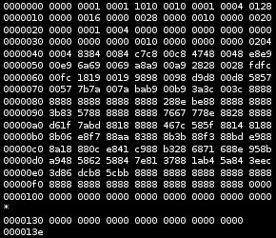
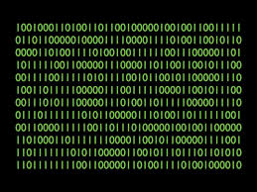
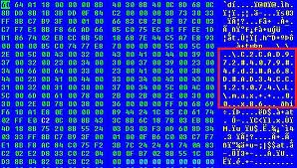
Distributed Systems
Machines ≈ Processes
Characteristics:
  No central control
    Local programs
    Local memories

Slide 6


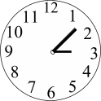
Distributed Systems
Machines ≈ Processes
Characteristics:
  No central control
    Local programs
    Local memories
  Asynchronous
  No global time

Slide 7
Distributed Systems
Machines ≈ Processes
Characteristics:
  No central control
    Local programs
    Local memories
  Asynchronous
  No global time
  Interconnected

Slide 8

Distributed Systems
Machines ≈ Processes
Characteristics:
  No central control
    Local programs
    Local memories
  Asynchronous
  No global time
  Interconnected
    Asynchronous & FIFO message-passing

Slide 9
Distributed Systems
Assumptions
  Bidirectional links

Slide 10
Distributed Systems
4078
167
Assumptions
  Bidirectional links
  Unique Ids
12
42
23

Slide 11
Distributed Systems
Assumptions
  Bidirectional links
  Unique Ids
  Static connected topology (≈graph)
4078
167
12
42
23

Slide 12
Distributed Systems
Assumptions
  Bidirectional links
  Unique Ids
  Static connected topology (≈graph)
  Deterministic machines
4078
167
12
42
23

Slide 13
Distributed Algorithm

Slide 14
Distributed Algorithm
Example: Computing a Spanning Tree

Slide 15
Distributed Algorithm
Example: Computing a Spanning Tree
Distributed Inputs
Root= true
Root= false
Root= false
Root= false
Root= false

Slide 16
Distributed Algorithm
Example: Computing a Spanning Tree
Distributed Inputs
R

Slide 17
Distributed Algorithm
Example: Computing a Spanning Tree
Distributed Inputs
Distributed Computations
  Local memories
  Local programs
  Message-passing
  Local decision
R

Slide 18
Distributed Algorithm
Example: Computing a Spanning Tree
Distributed Inputs
Distributed Computations
  Local memories
  Local programs
  Message-passing
  Local decision
Distributed Outputs
R

Slide 19
Distributed Algorithm
Example: Computing a Spanning Tree
Distributed Inputs
Distributed Computations
  Local memories
  Local programs
  Message-passing
  Local decision
Distributed Outputs
Global Task
R

Slide 20
Classical problems
Data Exchanges: Routing, Broadcast, PIF, …
Agreement: Consensus, Leader Election, Atomic Register, …
Self-Organization: Spanning Tree, Clustering
Resource Allocation: Mutual Exclusion, L-Exclusion, K-out-of-L-Exclusion…

Slide 21
Performance Evaluation
There are efficient solutions for most of the classical problems!
#Messages
  O(#Processes)
Volume (in bits)
  Polynomial in #Processes
Time Complexity (in rounds)
  O(Diameter)
Local Space(in bits)
  O(Degree)
… assuming the system is fault-free

Slide 22
Challenges
Modern distributed systems are large-scale and made of cheap heterogeneous units, e.g.
  Internet
    (10 billions of connected machines in 2016)
    Internet of things
  Wireless Sensor Networks
    Message losses due to the radio medium
    Process crashes due to limited batteries
⇒ High probability of faults
⇒ Human intervention impossible
⇒ Need of Fault-Tolerant Distributed Algorithms

Slide 23
Fisher, Lynch, and Paterson, 1985
“The deterministic consensus cannot be solved in a asynchronous distributed system in spite of at most one faulty process”
(no information about the fault)
Even if
  the communications are reliable
  The network is fully connected

Slide 24
Consensus
Input in {0,1}
0
1
1
0
1

Slide 25
Consensus
Input in {0,1}
Output in {0,1}
0
1
1
0
1

Slide 26
Consensus
Input in {0,1}
Output in {0,1}
  Agreement
0
0
0
1
0
1
0
0
0
1

Slide 27
Consensus
Input in {0,1}
Output in {0,1}
  Agreement
  Termination
    (for all corrects)
0
0
0
1
0
1
0
0
0
1

Slide 28
Consensus
Input in {0,1}
Output in {0,1}
  Agreement
  Termination
    (for all corrects)
  Integrity
    (1 write)
0
0
0
1
0
1
0
0
0
1

Slide 29
Consensus
Input in {0,1}
Output in {0,1}
  Agreement
  Termination
    (for all corrects)
  Integrity
    (1 write)
  Validity
0
0
0
0
0

Slide 30
Consensus
Input in {0,1}
Output in {0,1}
  Agreement
  Termination
    (for all corrects)
  Integrity
    (1 write)
  Validity
0
0
0
0
0
0
0
0
0
0

Slide 31
Consensus
Input in {0,1}
Output in {0,1}
  Agreement
  Termination
    (for all corrects)
  Integrity
    (1 write)
  Validity
1
1
1
1
1

Slide 32
Consensus
Input in {0,1}
Output in {0,1}
  Agreement
  Termination
    (for all corrects)
  Integrity
    (1 write)
  Validity
1
1
1
1
1
1
1
1
1
1

Slide 33
Strenght of the result
Most of the distributed problem can be reduced to the consensus, e.g.
  Atomic broadcast
  Atomic register
  Replicated state machine
  …

Slide 34
Circumvent the impossibility
Relax the hypothesis, e.g.,
  Initial crash
  Partial Synchronous Assumptions
  Add information about the failures (failure detectors)
Relax the solved problem
  Probabilistic consensus
  Self-stabilization

Slide 35
Self-Stabilization

Slide 36
Self-Stabilization
Dijkstra, 1974
Versatile technique to tolerate arbitrary transient failures

Slide 37
Transient Failures
Location: node or link
Duration: finite
Frequency: low
e.g.
Node: memory corruption
Link: message losses, message corruption, message duplication, message creation, reordering

Slide 38
BFS Spanning Tree [Huang & Chen, 1992]
R

Slide 39
BFS Spanning Tree [Huang & Chen, 1992]
0
0
0
R
0
0
0
0

Slide 40
BFS Spanning Tree [Huang & Chen, 1992]
0
0
0
R
0
0
0
0
0
0
0
0
0
0
0
0
0
0
0
0
0

Slide 41
BFS Spanning Tree [Huang & Chen, 1992]
0
0
0
R
0
0
0
0
0
0
0
0
0
0
0
0
0
0
0
0
0

Slide 42
BFS Spanning Tree [Huang & Chen, 1992]
0
0
0
0
0
0
0
R
0
0
0
0
0
0
0
0
0
0
0
0
0
0
0
0
0
0
0
0
0
0
0
0
0
0
0
0
0

Slide 43
BFS Spanning Tree [Huang & Chen, 1992]
0
0
0
0
0
0
0
R
0
0
0
0
0
0
0
0
0
0
0
0
0
0
0
0
0
0
0
0
0
0
0
0
0
0
0
0
0

Slide 44
BFS Spanning Tree [Huang & Chen, 1992]
0
0
0
0
0
0
0
R
0
0
0
0
0
0
0
0
0
0
0
0
0,1
0
0
0
0
0
0
1,0
0
0
0
0,1
1
0
0
0
0

Slide 45
BFS Spanning Tree [Huang & Chen, 1992]
0
0
1
1
1
1
1
R
0
0
0
0
0
0
1
1
0
1
0
0
1
1
1
1
0
0
0
1
1
0
1
1
1
1
1
0
0

Slide 46
BFS Spanning Tree [Huang & Chen, 1992]
0
0
1
1
1
2
2
R
0
1
1
0
1
0
1
1
0
1
1
1
2
1
1
1
0
1
1
2
2
1
1
2
2
2
1
1
1

Slide 47
BFS Spanning Tree [Huang & Chen, 1992]
0
0
1
1
1
2
2
R
0
2
1
0
2
0
1
1
0
1
1
2
2
1
1
1
0
1
1
2
3
1
1
2
2
3
1
2
2

Slide 48
BFS Spanning Tree [Huang & Chen, 1992]
0
0
1
1
1
2
2
R
0
2
1
0
2
0
1
1
0
1
1
2
2
1
1
1
0
1
1
2
3
1
1
2
2
3
1
3
2

Slide 49

BFS Spanning Tree [Huang & Chen, 1992]
In case of transient faults ?
0
0
1
1
1
2
2
R
0
2
1
0
2
0
1
1
0
1
1
2
2
1
1
1
0
1
1
2
0
1
1
2
2
0
0
1
3

Slide 50
BFS Spanning Tree [Huang & Chen, 1992]
In case of transient faults ?
0
0
1
1
1
2
2
R
0
2
1
0
2
0
1
1
0
1
1
2
1
1
1
1
0
1
1
1
3
1
1
1
1
0
2
3
1

Slide 51
BFS Spanning Tree [Huang & Chen, 1992]
In case of transient faults ?
0
0
1
1
1
2
2
R
0
2
1
0
1
0
1
1
0
1
1
1
2
1
1
1
0
1
1
2
2
1
1
2
2
3
1
2
1

Slide 52
BFS Spanning Tree [Huang & Chen, 1992]
In case of transient faults ?
0
0
1
1
1
2
2
R
0
2
1
0
2
0
1
1
0
1
1
2
2
1
1
1
0
1
1
2
3
1
1
2
2
2
2
3
1

Slide 53
BFS Spanning Tree [Huang & Chen, 1992]
In case of transient faults ?
0
0
1
1
1
2
2
R
0
2
1
0
2
0
1
1
0
1
1
2
2
1
1
1
0
1
1
2
3
1
1
2
2
3
2
3
1

Slide 54
Definition:
Closure + Convergence + Correctness
Closure+Correctness
Illegitimate States
Legitimate States
Convergence
States of the System

Slide 55
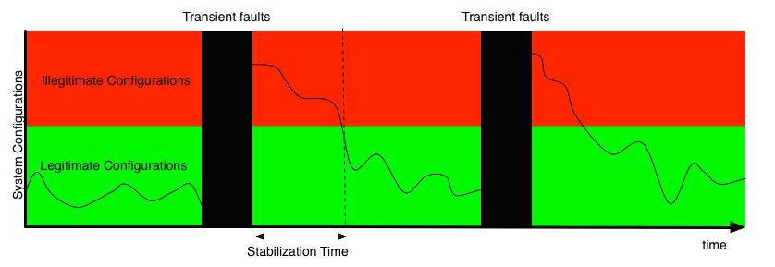
Advantages of Self-Stabilization
Tolerate transient faults

Slide 56
Advantages of Self-Stabilization
Lightweight
  Low overhead
No initialization
  Large-scale network
  Self-organization in wireless sensor network
Tolerate (detectable) topological changes

Slide 57
Advantages of Self-Stabilization
Easy to compose:
  Collateral Composition A ➔B
    A and B runs in parallel
    B does not write into A variables
Example
  Compose
    Spanning tree construction and
    Node-Counting along a tree

Slide 58
Composition
Node-Counting
0,2
R
3,4
2,1
5,2
0,2
3,8

Slide 59
Composition
Node-Counting
6,6
R
6,2
4,2
1,4
1,4
1,1

Slide 60
Composition
Node-Counting
11,11
R
3,6
2,6
1,2
1,2
1,2

Slide 61
Composition
Node-Counting
6,6
R
3, 11
2,
11
1,6
1,6
1,6

Slide 62
Composition
Node-Counting
6,6
R
3,6
2,6
1, 11
1, 11
1, 11

Slide 63
Composition
Node-Counting
6,6
R
3,6
2,6
1,6
1,6
1,6

Slide 64
Composition:
Spanning Tree + Node Counting
2,2
3,1
1,1
R
4,1
1,1
3,1
1,1

Slide 65
Composition:
Spanning Tree + Node Counting
1,1
1,1
1,1
R
4,1
1,1
2,1
1,1

Slide 66
Composition:
Spanning Tree + Node Counting
7,7
4,1
1,1
R
1,1
1,1
2,1
1,1

Slide 67
Composition:
Spanning Tree + Node Counting
7,7
4,7
1,1
R
1,7
1,7
2,1
1,1

Slide 68
Composition:
Spanning Tree + Node Counting
7,7
4,7
1,7
R
1,7
1,7
2,7
1,1

Slide 69
Composition:
Spanning Tree + Node Counting
7,7
4,7
1,7
R
1,7
1,7
2,7
1,7

Slide 70
Drawbacks of Self-Stabilization
Temporary Loss of Safety
  Goal: Minimize the stabilization time
  Stronger forms of Self-Stabilization
    Fault-Containment [Ghosh & al, 1996],
    Superstabilization [Dolev & al, 1997],
    Safe Convergence [Kakugawa & al, 2002],
    …
No local detection of stabilization
  Permanent local checks
Overhead

Slide 71
Performance Evaluation
Time Complexity
  Mainly, the Stabilization Time
Memory Requirement
Overhead (Algo_{Self}/OptAlgo_{Safe})
Necessary knowledges (Local vs Global)

Slide 72
Competitive Self-Stabilizing k-Clustering
[Datta, Devismes, Heurtefeux, Larmore, Rivierre, ICDCS’2012]

Slide 73
k-Clustering

Slide 74
k-Clustering

Slide 75
k-Clustering
Ex. k=2
≤k

Slide 76
k-Clustering
Ex. k=2
≤k

Slide 77
k-Clustering
Goal: Minimize the number of clusters
Find the optimal k-Clustering of an arbitrary graph is NP-Hard [Garey & Johnson, 1979]
Contribution: Self-stabilizing k-Clustering of bounded size

Slide 78
Roadmap
Solution for tree networks
Generalization for arbitrary connect networks
Study of special cases:
  Unit Disk Graphs (UDG)
  Approximate Disk Graphs (ADG)

Slide 79

k-Clusterheads Selection: α

Slide 80
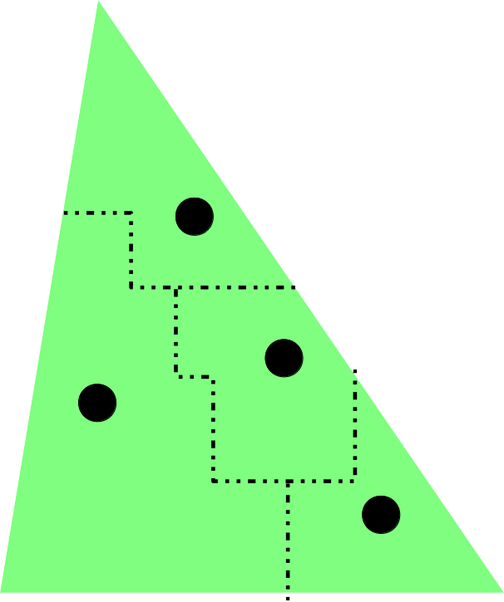
k-Clusterheads Selection: α

Slide 81
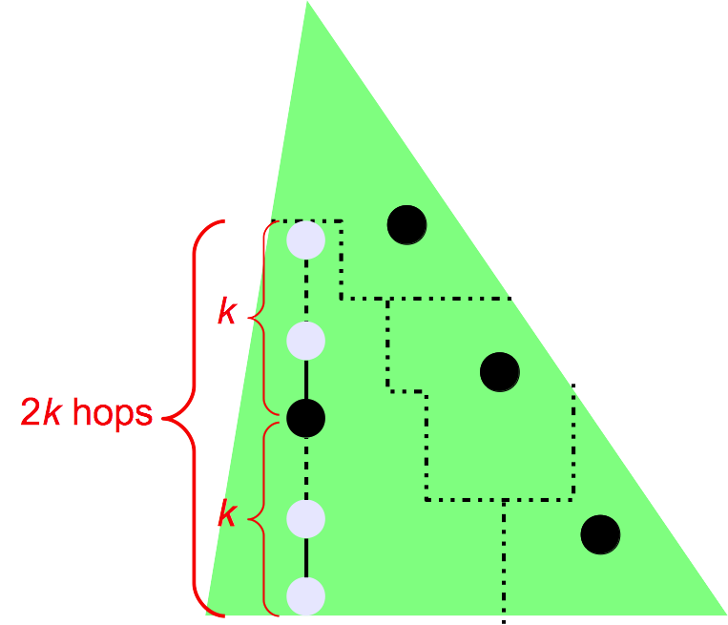
k-Clusterheads Selection: α

Slide 82
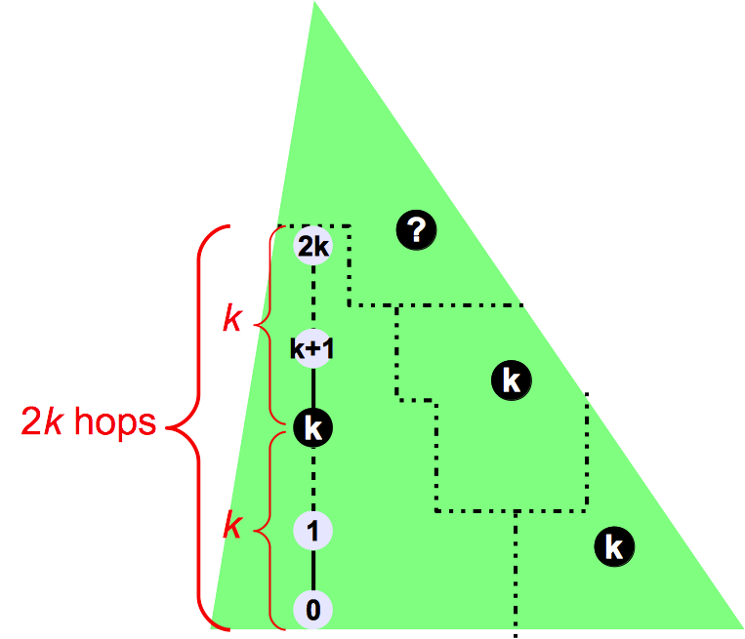
k-Clusterheads Selection: α

Slide 83
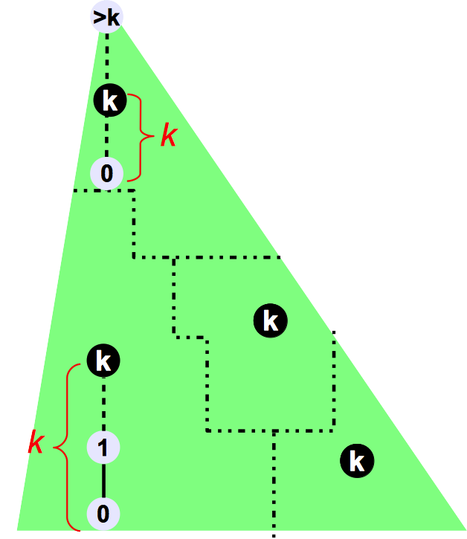
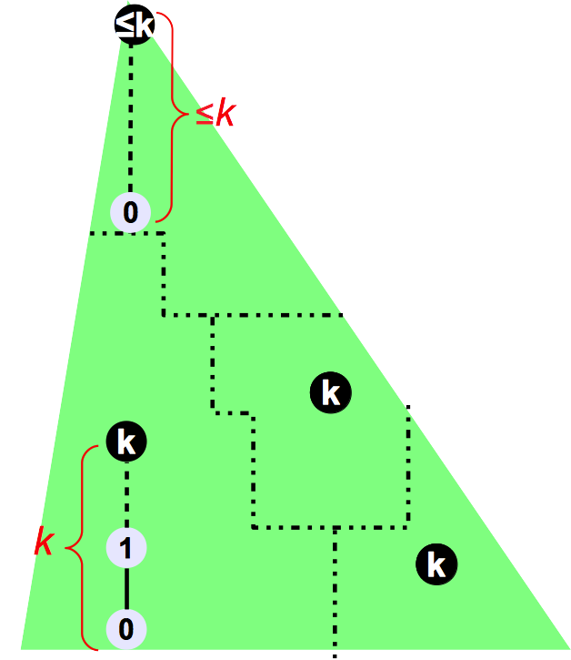
k-Clusterheads Selection: α

Slide 84
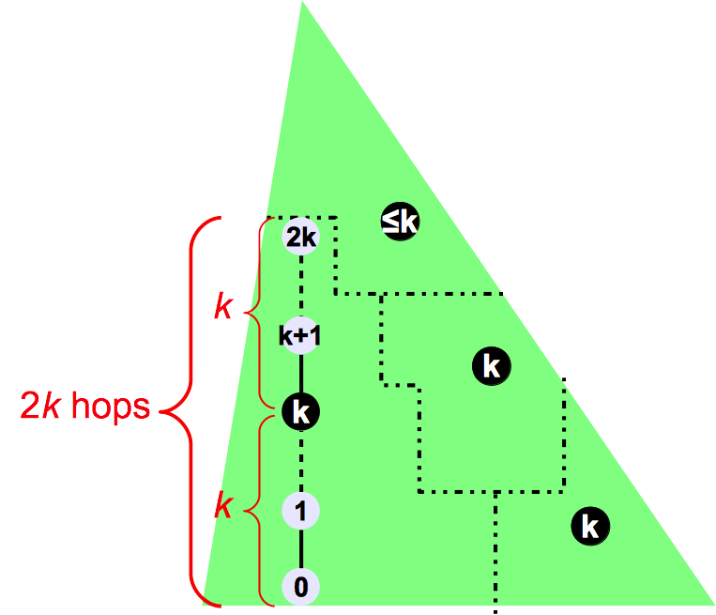
k-Clusterheads Selection: α

Slide 85
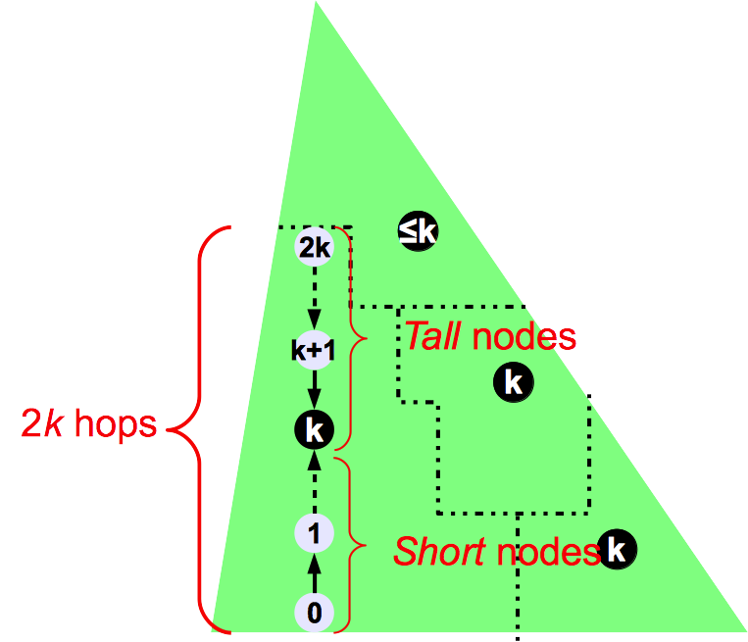
k-Clusterheads Selection: α

Slide 86
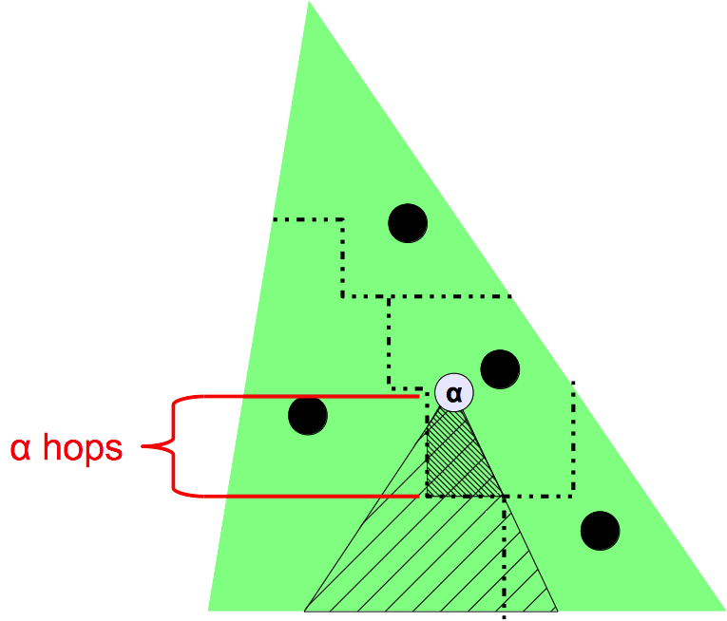
k-Clusterheads Selection: α

Slide 87

k-Clusterheads Selection: α

Slide 88
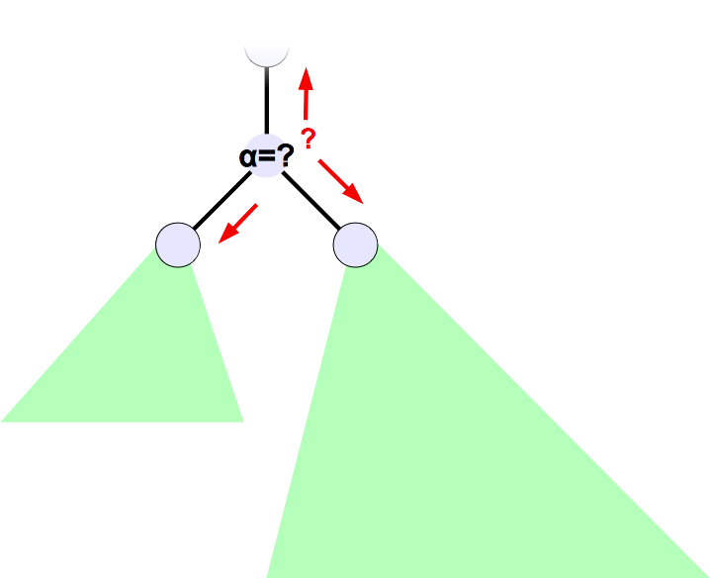
k-Clusterheads Selection: α

Slide 89
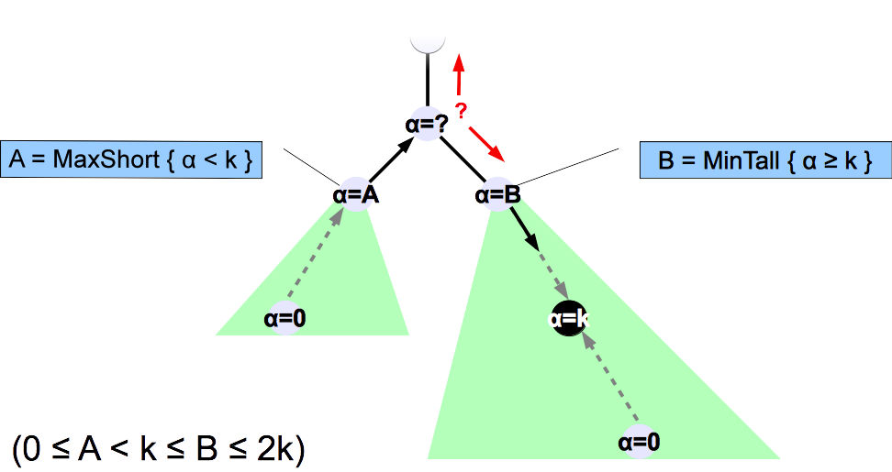
k-Clusterheads Selection: α

Slide 90
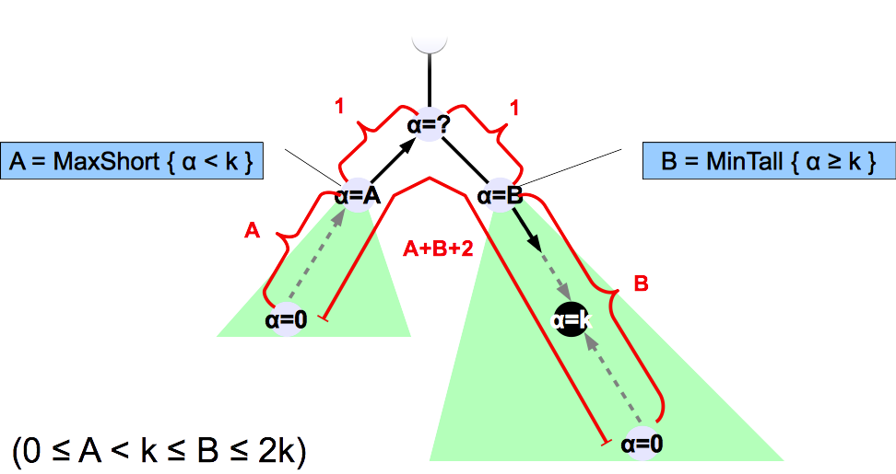
k-Clusterheads Selection: α

Slide 91
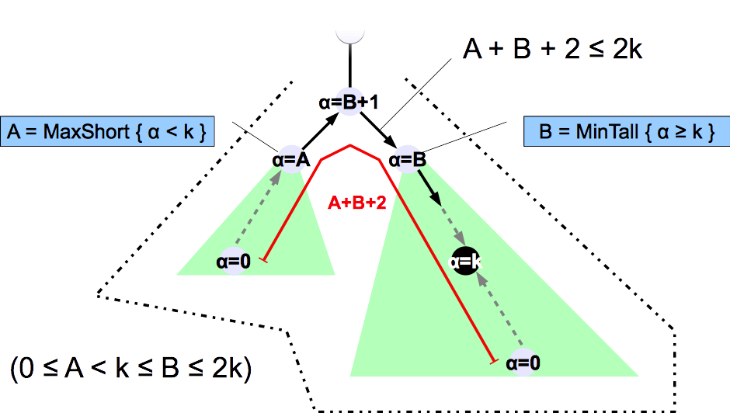
k-Clusterheads Selection: α

Slide 92
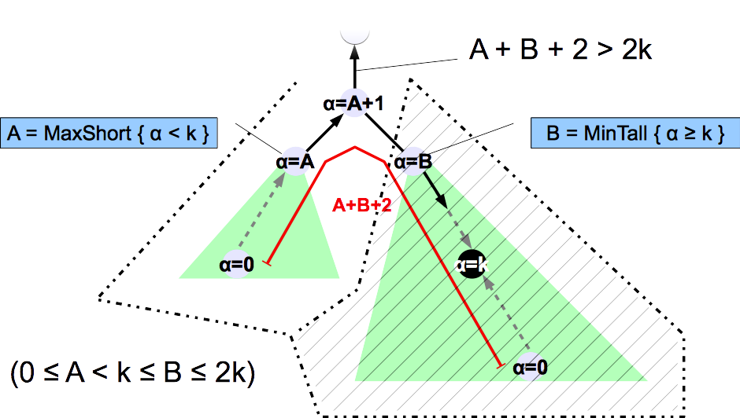
k-Clusterheads Selection: α

Slide 93
Sum Up
In trees :
  O(log n + log k) space
  O(n) rounds
  #clusterheads: Optimal
In arbitrary networks ?

Slide 94
Arbitrary Networks
Any Spanning Tree
Tree k-Clustering
e.g., [Huand & Chen, 1992]
O(log n + log k) space
O(n) rounds
#clusterheads: Not optimal, but bounded

Slide 95
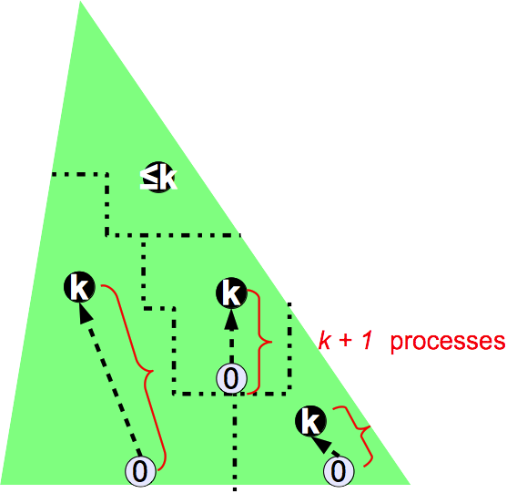
Arbitrary Networks

Slide 96
In Unit Disk Graph (UDG) ?
1

Slide 97
Result in UDG
7.2552k+0(1)-competitive if
An algorithm is X-competitive if it builds a k-clustering of size at most X times the smallest possible number of k-clusters.
  |Clr| ≤ X.|Min|
MIS Tree
Tree k-Clustering

Slide 98
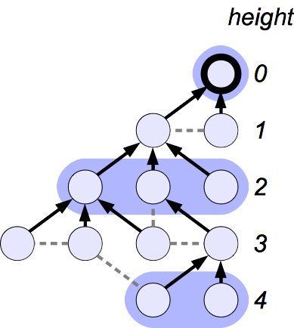
MIS Tree
Maximal Independent Set

Slide 99
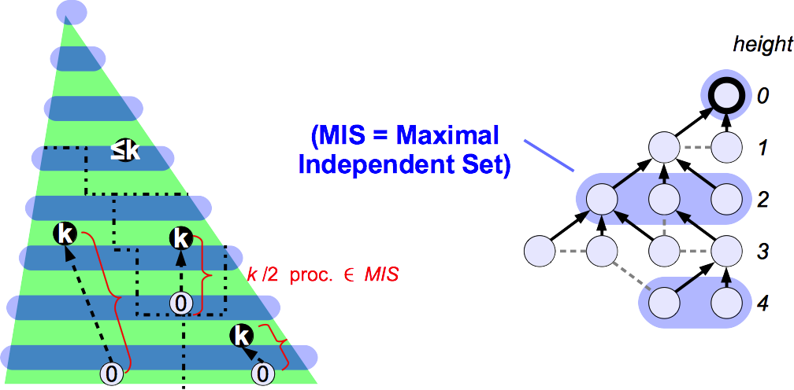
k-clustering vs MIS
  (|Clr| - 1) k/2 ≤ |MIS| - 1

Slide 100
MIS vs CLR_{opt}
Let C be any cluster of CLR_{opt}

Slide 101
MIS vs CLR_{opt}
Let C be any cluster of CLR_{opt}
Let I be any independent set of C

Slide 102
MIS vs CLR_{opt}
Let C be any cluster of CLR_{opt}
Let I be any independent set of C
UDG: ∀p,q ∊ I, d(p,q) > 1

Slide 103
MIS vs CLR_{opt}
Let C be any cluster of CLR_{opt}
Let I be any independent set of C
UDG: ∀p,q ∊ I, d(p,q) > 1
[Folkman & Graham,1969]
X: compact convex region
I ⊆ X, ∀p,q ∊ I, d(p,q) ≥ 1
|I| ≤ ⎣2A(X)/√3+P(X)/2+1⎦

Slide 104
MIS vs CLR_{opt}
Let C be any cluster of CLR_{opt}
Let I be any independent set of C
UDG: ∀p,q ∊ I, d(p,q) > 1
k
[Folkman & Graham,1969]
X: compact convex region
I ⊆ X, ∀p,q ∊ I, d(p,q) ≥ 1
|I| ≤ ⎣2A(X)/√3+P(X)/2+1⎦

Slide 105
MIS vs CLR_{opt}
Let C be any cluster of CLR_{opt}
Let I be any independent set of C
UDG: ∀p,q ∊ I, d(p,q) > 1
|I| ≤ ⎣2𝛑k²/√3+𝛑k+1⎦
Let IS any independent set of CLR_{opt}
|IS| ≤ ⎣2𝛑k²/√3+𝛑k+1⎦.|CLR_{opt}|
K
[Folkman & Graham,1969]
X: compact convex region
I ⊆ X, ∀p,q ∊ I, d(p,q) ≥ 1
|I| ≤ ⎣2A(X)/√3+P(X)/2+1⎦

Slide 106
Result
  |MIS| ≤ ⎣2𝛑k²/√3+𝛑k+1⎦.|CLR_{opt}|
  (|Clr| - 1) k/2 ≤ |MIS| - 1
  ⇒|Clr| ≤ 1-2/k+(4𝛑k/√3+2𝛑+2/k). |CLR_{opt}|
  ⇒ 7,2552k+O(1)-competivity

Slide 107
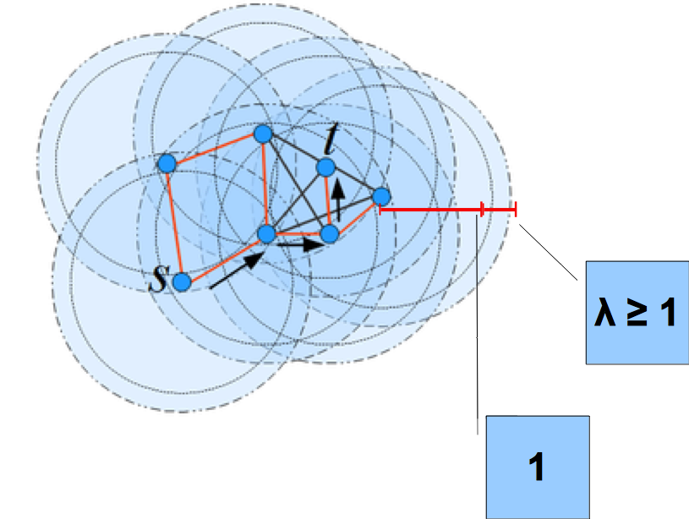
In Approximate Disk Graphs
  7,2552λ²k+O(1)-competivity

Slide 108
Conclusion
Self-stabilization is funny !

Slide 109
Bibliography
Stéphane Devismes, Franck Petit, and Vincent Villain. Autour de l'Auto-stabilisation. Partie I : Techniques généralisant l'approche.
Technique et Science Informatiques (TSI), Vol 30(7), pages 873-894. 2010.
Stéphane Devismes, Franck Petit, and Vincent Villain. Autour de l'Auto-stabilisation. Partie II : Techniques spécialisant l'approche.
Technique et Science Informatiques (TSI), Vol 30(7), pages 895-922. 2010.
Ajoy K. Datta, Lawrence L. Larmore, Stéphane Devismes, Karel Heurtefeux, and Yvan Rivierre. Self-Stabilizing Small k-Dominating Sets.
International Journal of Networking and Computing, Volume 3, Issue 1, pages 116-136. 2013.
Ajoy K. Datta, Stéphane Devismes, Karel Heurtefeux, Lawrence L. Larmore, and Yvan Rivierre. Competitive Self-Stabilizing k-Clustering.
In Proceedings of The 32nd International Conference on Distributed Computing Systems (ICDCS'12). Pages 476-485, June 18-21, 2012, Macau, China.
Ajoy K. Datta, Stéphane Devismes, and Lawrence L. Larmore. A Self-Stabilizing O(n)-Round k-Clustering Algorithm.
In Proceedings of SRDS'2009, 28th International Symposium on Reliable Distributed Systems. Pages 147-155, September 27-30, 2009, Niagara Falls, New York, USA.

Slide 110
Thank you!

