Slide 1

Versatility and Efficiency in
Self-stabilizing Distributed Systems
Stéphane Devismes
Habilitation à diriger des recherches
Panel:
Pr. Carole Delporte-Gallet, Univ. Denis Diderot, Paris (Examiner)
Pr. Toshimitsu Masuzawa, Osaka Univ. (Reviewer)
Pr. Jean-François Monin, Univ. Grenoble Alpes (Examiner)
Pr. Achour Mostéfaoui, Univ. of Nantes (Reviewer)
Pr. Michel Raynal, Univ. of Rennes (Examiner)
Pr. Christian Scheideler, Univ. of Paderborn (Reviewer)
Pr. Denis Trystram, Grenoble INP (President)
Notes:
This talk is about my research activities along the last 17 years

Slide 2
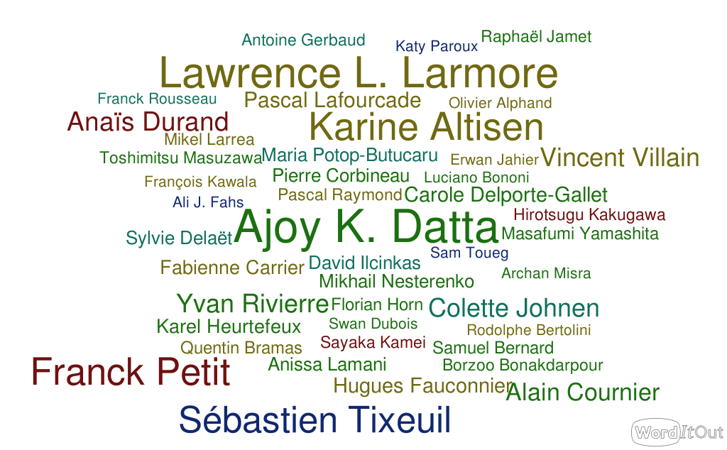
Co-authors:
Main collaborations in France: ICUBE, IRIF, IRISA, LaBRI, LIMOS, LIG, LIP6, MIS, VERIMAG
International collaborations: Univ. Basque Country, Cornell, Hiroshima Univ., Kent-State Univ., Kyushu Univ., Osaka Univ., UNLV, Waterloo Univ.
Projects: ANR Descartes, ANR ESTATE, Equipe-Action IoIT, …
Supervised PhD students: Anaïs Durand, Yvan Rivierre
Notes:
Along those years, I have worked with many people
from the main french laboratories
and also from several foreign Universities
I have participated to several research projects
I have supervised many students, and I published papers with some of them, in particular the 2 PhD student I have supervised

Slide 3
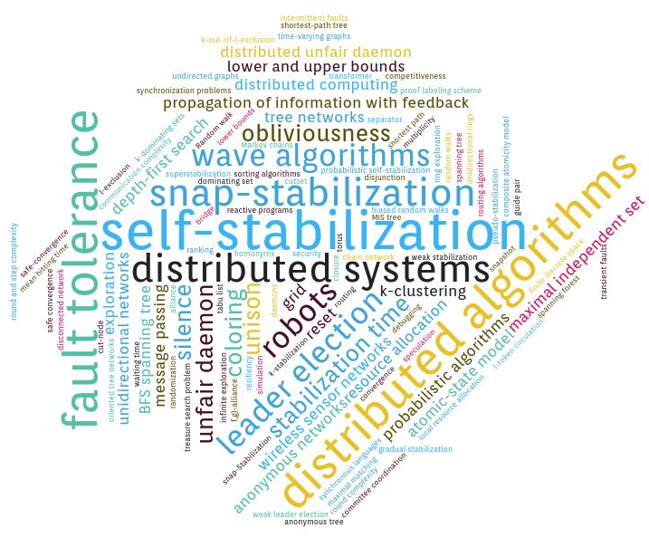
Notes:
I have worked on many different fields, e.g., robot computing, wsn, security, certification, or randomized algorithms
...
However, my main topics remains ...
So, as an introduction, I will now define and motivate these topics

Slide 4

Distributed Algorithm?
An algorithm dedicated to distributed systems
Notes:
2min20

Slide 5
Distributed System?
Notes:
So what is a distributed system

Slide 6


Distributed System?
A set of computing entities, called processes
  autonomous
      local program and memory, no synchronization, no global time
  interconnected
      information exchanges

Slide 7
Distributed System?
A set of computing entities, called processes
  narrow local view
  maybe outdated received information
Notes:
The specificities are

Slide 8
Distributed System?
A set of computing entities, called processes
  Collaborating to solve a global task
Notes:
Despite these weaknesses,

Slide 9

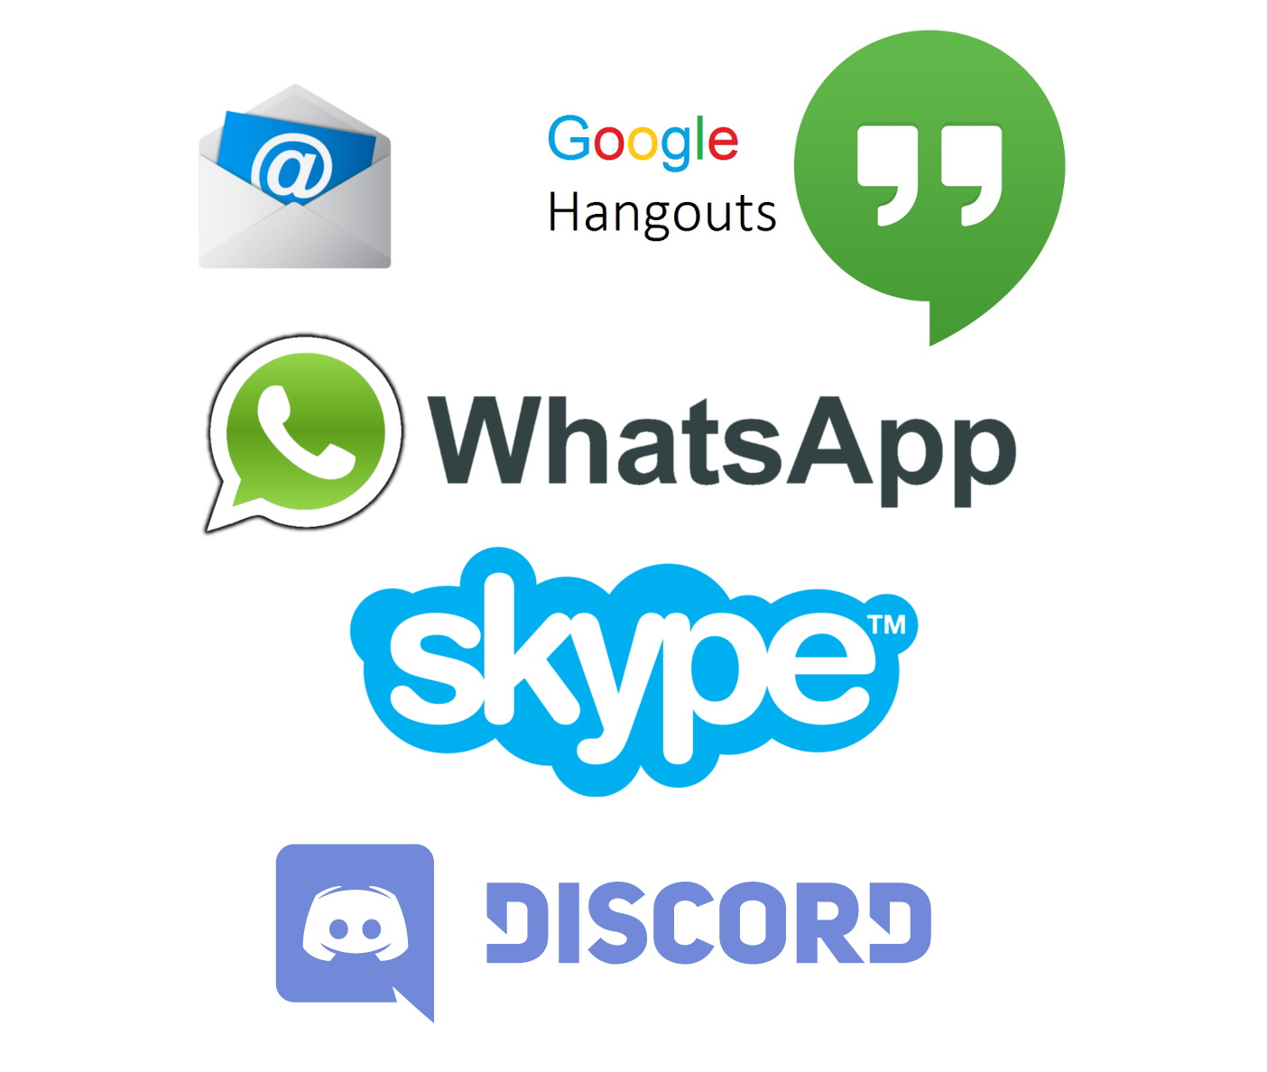
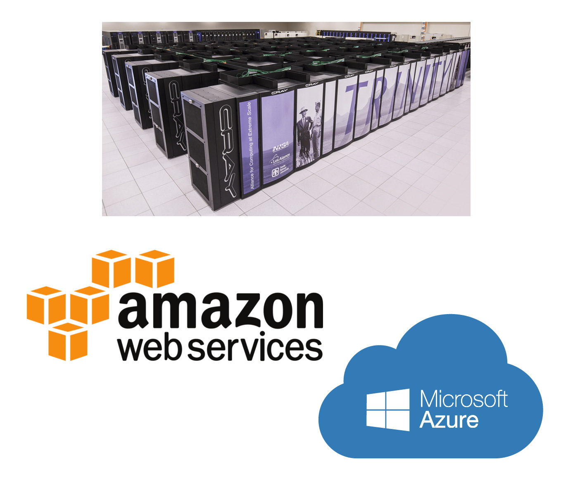
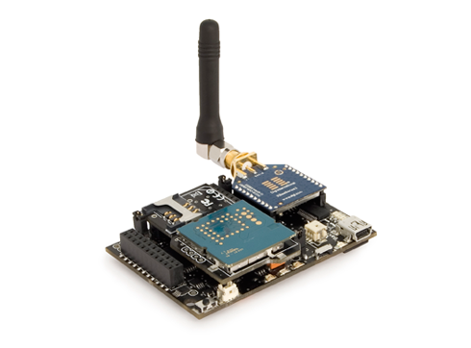
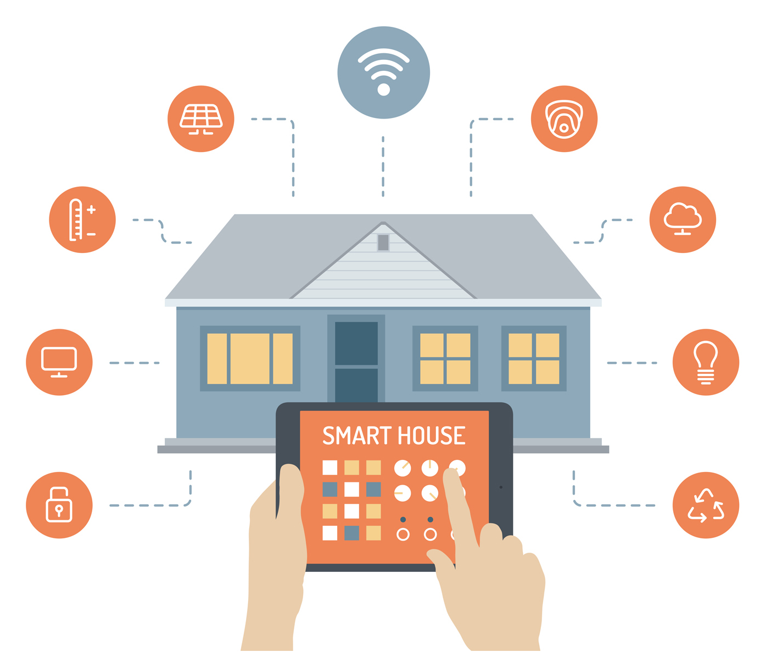
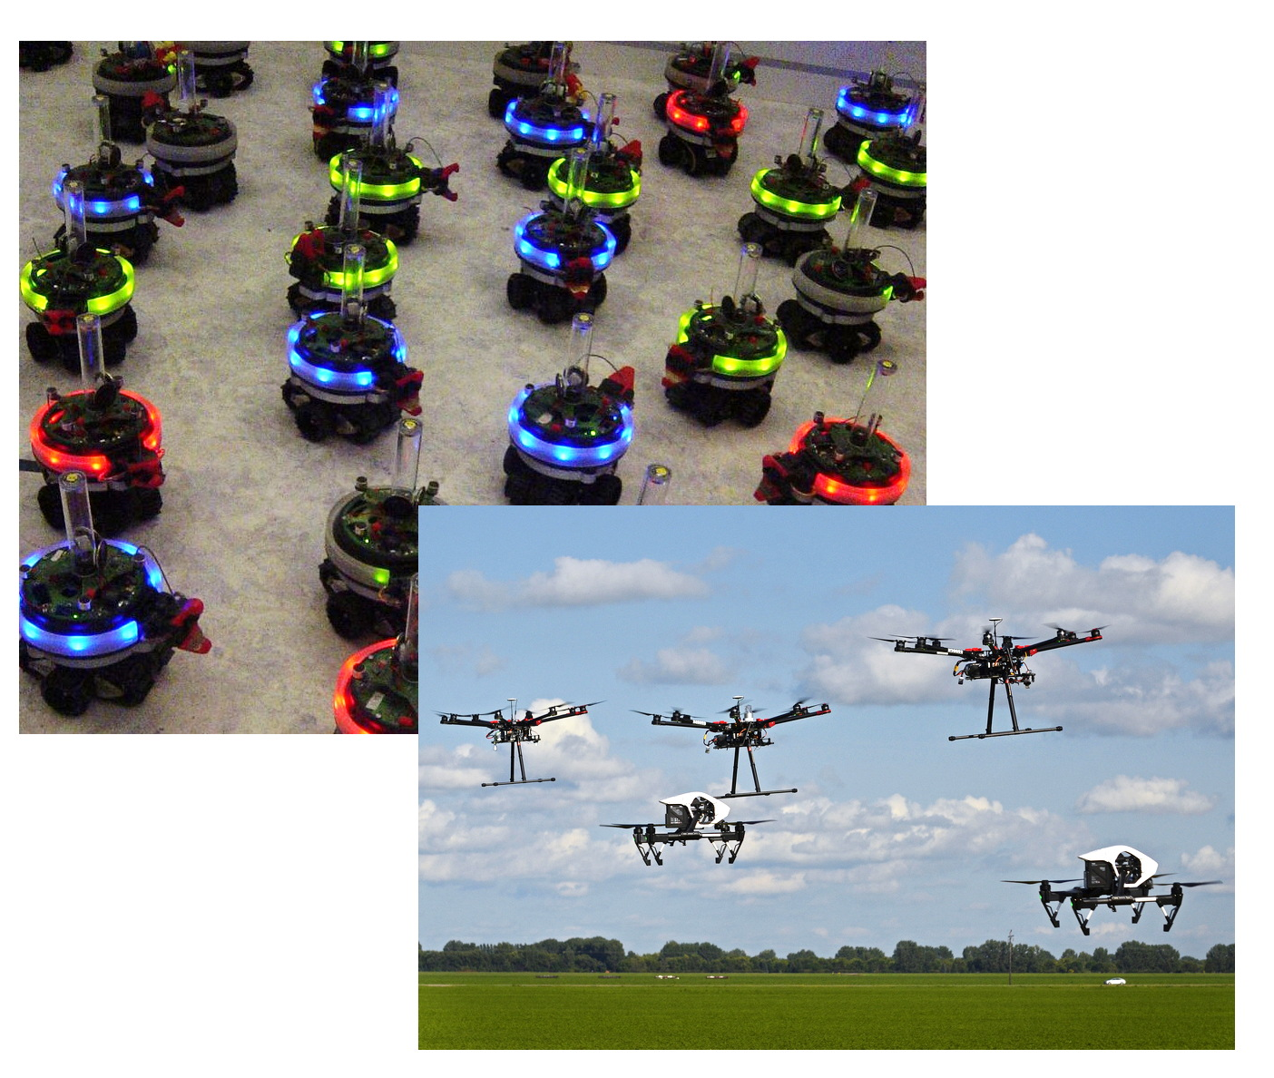
Various Systems and Applications
Notes:
Nowadays
Ubiquitous: SD are everywhere
we have a huge variety of systems
and a wide range of applications

Slide 10
Challenges
Several possible sources of uncertainty:
  Asynchrony
  Faults
  Evolving network topology
  Mobility
  …
Notes:
The main challenge in these systems is that we have several sources of uncertainty

Slide 11
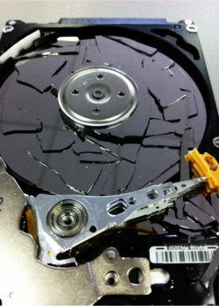
Faults?
A process or a link deviates from its specification
Temporary: transient vs. intermittent
  Transient: low frequency (rare)
  Intermittent: high frequency
Fault | Localization | Cause | Duration
Crash | Process | Benign | Permanent
Loss of messages | Link | Benign | Temporary
Memory corruption | Process | Benign | Temporary
Byzantine | Process | Malign | Permanent
Notes:
we have many kinds of faults
they can be classified according to many criteria
An important criterion is the duration of the fault
when the duration is finite: we have an important distinction between transient and intermittent
this distinction drastically impacts the way a temporary fault is treated

Slide 12
Faults?
A process or a link deviates from its specification
Temporary: transient vs. intermittent
  Transient: low frequency (rare)
  Intermittent: high frequency
Fault | Localization | Cause | Duration
Crash | Process | Benign | Permanent
Loss of messages | Link | Benign | Temporary
Memory corruption | Process | Benign | Temporary
Byzantine | Process | Malign | Permanent
Notes:
we have many kinds of faults
they can be classified according to many criteria
An important criterion is the duration of the fault
when the duration is finite: we have an important distinction between transient and intermittent
this distinction drastically impacts the way a temporary fault is treated

Slide 13
Fault Tolerance?
Ability of an algorithm to automatically
  withstand (masking approach)
  or recover from (non-masking approach)
failures.
The possibility of failure should be directly considered in the design of the distributed algorithms.

Slide 14
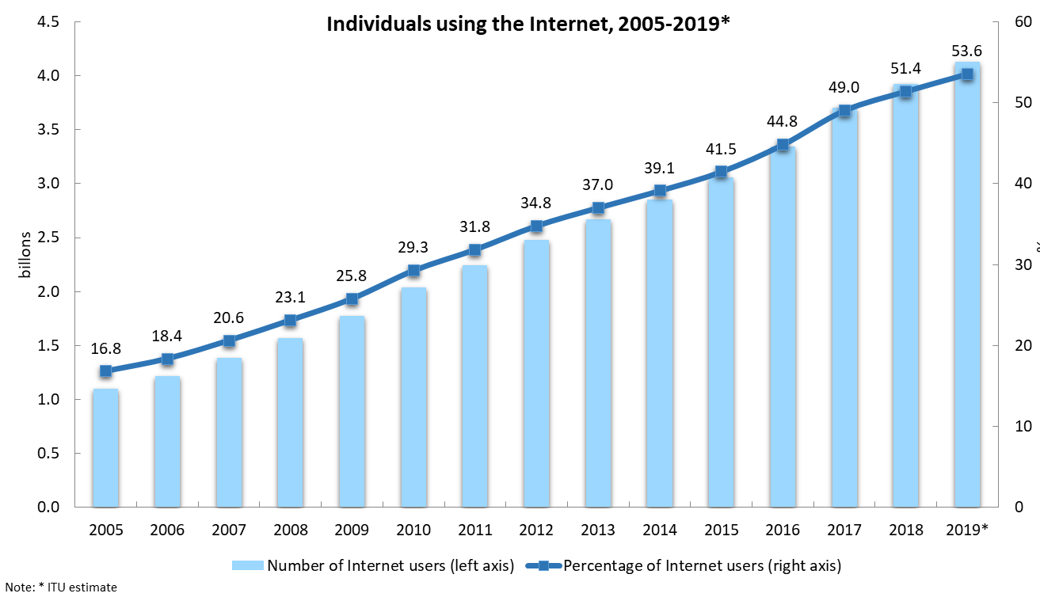

The Increasing Need of Fault Tolerance in Modern Networks
Large-scale
  the size of a network ↗ $⇒$ the probability of failures ↗
  geographically spread: no human intervention to repair them
Notes:
Moreover large-scale implies geo ...spreading

Slide 15
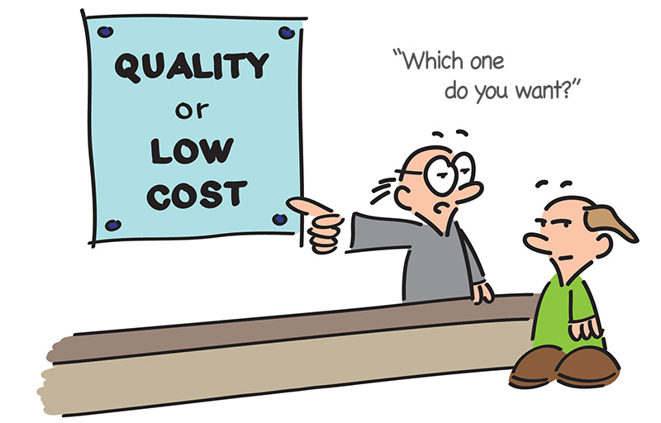
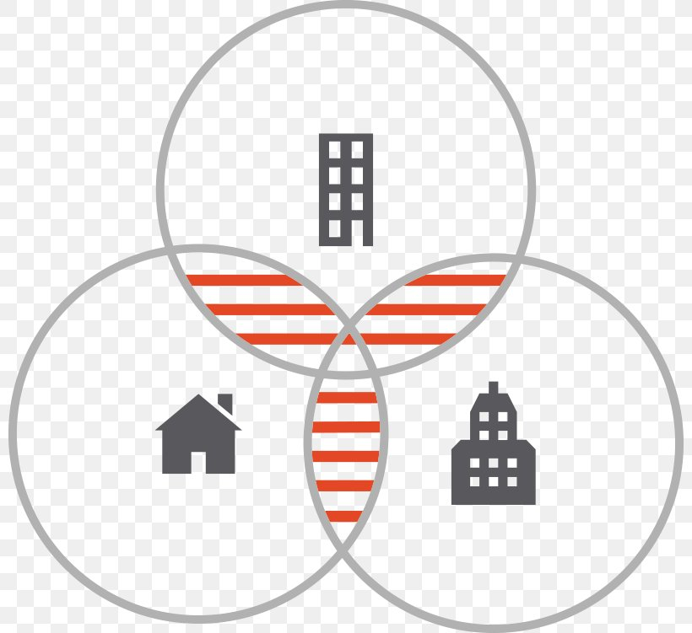

The Increasing Need of Fault Tolerance in Modern Networks
New technologies
  Heterogeneous entities 📱 🕹 💻⌚︎⌚︎ ⌚️
  Mass-produced at low cost
  Advent of wireless communications
  Smart objects with limited battery life
Notes:
they typically used unreliable wireless communication media
and have limited battery life

Slide 16

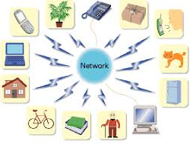
The Increasing Need of Fault Tolerance in Modern Networks
New usages: increasing need of availability
  Critical applications
  Ubiquitous: ↗ dependency on networks
Notes:
The need of availability is not only for critical application
Indeed, people are more and more dependent to network in their daily life

Slide 17
The Difficulty of Achieving Fault Tolerance
Impossibility of Distributed (Deterministic) Consensus with One Faulty Process [Fisher, Lynch, Paterson, JACM 1985]
The simplest agreement problem
Most of distributed computing problems require agreement
  e.g., detection termination, barrier synchronization, commit in distributed databases
Favorable | Unfavorable
Binary consensus | Asynchronous
Fully connected network | At most one process crash
Reliable Links
Notes:
However, achieving fault tolerance in SD is difficult
See illustrate this, let's recall the fundamental result of FLP
consensus: every process has an input value. All processes should decide the same value which must be one of the inputs
Why it is so fundamental : because it has been establish in spike of many favorable assumptions
On the other side, we have asynchrony and a simple failure pattern
Now solving this simple problem is fundamental indeed ...

Slide 18
Circumventing the impossibility
In partially synchronous systems
    [Dwork, Lynch, Stockmeyer, JACM 1988]
When information on crashes is available
    Initially dead [Fisher, Lynch, Paterson, JACM 1985]
    Failure detectors [Chandra, Toueg, JACM 1996]
If the specification is weakened
    Probabilistic consensus [Ben-Or, PODC 1983]
    Eventual consensus [Kuhn, Moses, Oshman, PODC 2011]
    Self-stabilization [Dijkstra, Comm. ACM 1974]
Notes:
Along the years, many ways to circumvent this impossibility have been studied
A small modification of the assumptions or problem statement make the problem solvable
Parler de non-masking approach : allows the system to temporarily violate its safety

Slide 19
Self-stabilization
Starting from any initial configuration, the system eventually reaches a legitimate configuration from which its behavior is correct. [Dijkstra, Comm. ACM 1974]

Slide 20
Tolerance to Transient Faults
Incorrect Behavior
Configurations
Correct Behavior
Time
Stabilization time
Notes:
Surprisingly, the definition does not make any reference to the notion of (transient) fault

Slide 21
Tolerance to Transient Faults
Transient faults
Incorrect Behavior
Configurations
Correct Behavior
Time
Stabilization time
Notes:
However, since by definition, transient faults last a finite time
the arbitrary initial configuration can be seem as the result of transient faults, since by definition they last a finite time

Slide 22
Tolerance to Transient Faults
Transient faults
Transient faults
Incorrect Behavior
Configurations
Correct Behavior
Time
Stabilization time
Notes:
Moreover, since transient faults are rare, we can expect a large time-window without fault to recover and then ensure the correct behavior for a long time
Of course, to increase the availability, we should also limit as much as possible the stabilization time

Slide 23
Roadmap
Efficiency in Self-stabilization
Versatility in Self-stabilization
Unifying Versatility and Efficiency in Self-stabilization
Detailed Example
Work in Progress and Perspectives
Notes:
13min15
In the remainder of this talk, I will summarize my contributions to the field of self-stabilization
I will speak of my works related to efficiency, versatility and
the way we can combine them
Then, I will detail a contribution
Finally, I will conclude with some ongoing works and perspectives

Slide 24
Efficiency in a Broad Sense
Complexity
  Stabilization time [Altisen, Cournier, SD, Durand , Petit, Inf. & Cmp. 2017]
  Space [Bernard, SD, Potop-Butucaru, Paroux, Tixeuil, ICDCN 2010]
  Communication efficiency [Delporte-Gallet, SD, Fauconnier, JPDC 2010]
  Problem-specific measures
    Concurrency/waiting time [Altisen, SD, Durand, JPDC 2017]
    Cost of wave [Cournier, SD, Villain, TAAS 2006]
Quality of the computed solutions
  Quantitative bounds [Datta, SD, Heurtefeux, Larmore, Rivierre, IJNC 2013]
  Approximation ratio [SD, Kakugawa, Kamei, Tixeuil, JCO 2013]
Assumptions and models [Datta, SD, Larmore, Villain, PPL 2017]
Fault tolerance guarantees
  Strong forms of self-stabilization
Notes:
I have worked on efficiency in a broad sense
Of course, I have dealt with efficiency in terms of complexity
that is, time comp, in particular enhancing the ST, space
CE : to limit the load of the network
and also problem-specific measures
Another important point is the quality of ... By quality I means, e.g., ensuring an interesting upper bound on the # of clusters in the clustering problem, for example. Or proposing a solution that achieves a good approximation ratio since in many case computing an optimal solution is NP-hard
Efficiency also means limiting hypotheses, considering
the weakest possible model
Finally. efficiency should be also evaluate at the light of the FT property ensured by the algorithm

Slide 25
Fault Tolerance Guarantees
Achieving strong forms of self-stabilization
  Beyond transient faults
    FTSS [Delporte-Gallet, SD, Fauconnier, JPDC 2010]
  Efficiently treating transient topological changes
    Gradual stabilization [Altisen, SD, Durand, Petit, JPDC 2019]
  Enhancing convergence in favorable cases
    Speculative self-stab. [Altisen, SD, Durand, Johnen, Petit, ICDCN 2021]
  Mitigating effects of loss of safety
    Safe convergence [Carrier, Datta, SD, Larmore, Rivierre, JPDC 2015]
    Snap-stabilization [Delaët, SD, Nesterenko, Tixeuil, JPDC 2010]
Notes:
idea: more precisely capture the fault tolerance quality of a solution
Strong form of SS can be classified according to the kind of extra property they ensure
- tolerate both transient and process crashes
- efficiently treat TC when they are transient
- e.g., reduce ST when the execution is sync
- reducing the effects of faults

Slide 26
Fault Tolerance Guarantees
Introducing strong forms of self-stabilization
  [Altisen, SD, Durand, Petit, JPDC 2019] (Anaïs Durand’s PhD thesis)
    Gradual stabilization
    Application to the Unison problem
    (a clock synchronization problem)
Notes:
Efficiency in terms of fault tolerance also implies the introduction of strong forms of self to more precisely capture the guarantees offered by a solution

Slide 27
Gradual Stabilization
[Altisen, SD, Durand, Petit, JPDC 2019] (Anaïs Durand’s PhD thesis)
Illegitimate configurations are not equally bad
  (spirit of safe convergence [Kakugawa, Masuzawa, IPDPS 2016])
Really bad
Bad: can be quickly left to better configurations
Not so bad: a minimum quality of service can be ensured
Configurations
Almost good: an even better specification can be ensured
Good (legitimate): the intended specification is guaranteed
Time
Notes:
For example, we may have this kind of classification
partition

Slide 28

Gradual Stabilization
[Altisen, SD, Durand, Petit, JPDC 2019] (Anaïs Durand’s PhD thesis)
Gradual Stabilization $⇒$ Self-stabilization
Transient faults
Configurations
Time
Notes:
First of all, gradual being a strong form
we have to ensure the convergence even in the worst case

Slide 29
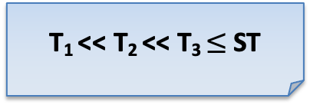
Gradual Stabilization
[Altisen, SD, Durand, Petit, JPDC 2019] (Anaïs Durand’s PhD thesis)
Additional properties after topological changes
  (spirit of superstabilization [Dolev, Herman, CJTCS 1995])
Transient faults
𝜏 topological changes of type 𝜚
T₁ << T₂ << T₃ $≤$ST
T₁
Configurations
T₂
T₃
Time
Notes:
conclure sur application à l'unisson

Slide 30
Roadmap
Efficiency in Self-stabilization
Versatility in Self-stabilization
Unifying Versatility and Efficiency in Self-stabilization
Detailed Example
Work in Progress and Perspectives
Notes:
17min20

Slide 31
Versatility in Self-stabilization
Composition
  [Datta, SD, Heurtefeux, Larmore, Rivierre, ICNC 2013]
Parametric solutions
  [Datta, SD, Heurtefeux, Larmore, Rivierre, TCS 2016]
  [Carrier, Datta, SD, Larmore, Rivierre, JPDC 2015]
  [Carrier, Datta, SD, Larmore, ICDCN 2015]
  [Datta, SD, Horn, Larmore, IJFCS 2011]
  [Altisen, SD, Durand, JPDC 2017]
Formalizing classical algorithmic patterns
  [Altisen, SD, Durand, SSS 2018]
Transformers/compilers
  [Cournier, Datta, SD, Petit, Villain, TCS 2016]
  [Cournier, SD, Villain, TAAS 2009]
Notes:
They are many way to achieve general algorithmic constructions
composition = modular approach to create algo from 2 sub al
k-clusrtering, l-Exclusion
formalizing classical algorithmic patterns: to obtain simple sufficient condition for SS and upper bounds on ST

Slide 32
Transformers/Compilers
Meta-algorithm: add an additional property to an input algorithm
Example: A solves task T → A’ is self-stabilizing for task T [Katz, Perry, Dist. Comp. 1993] (message passing)
Contribution: snap-stabilization/self-stabilization [Cournier, Datta, SD, Petit, Villain, TCS 2016]
Notes:
that turn A into A'

Slide 33
Snap-stabilization
[Bui, Datta, Petit, Villain, WSS 1999]
Strong form of self-stabilization
Focus on starting actions
  e.g., Traversal: finite task where all nodes are visited between the start and the end.
Self-/Snap-stabilization: endless repetitions of tasks
Transient faults
Finite (yet unbounded in general)
number of times
Self-stabilizing Algorithm
Resume a correct behavior since the first started task after faults
Transient faults
First start
Snap-stabilizing Algorithm

Slide 34
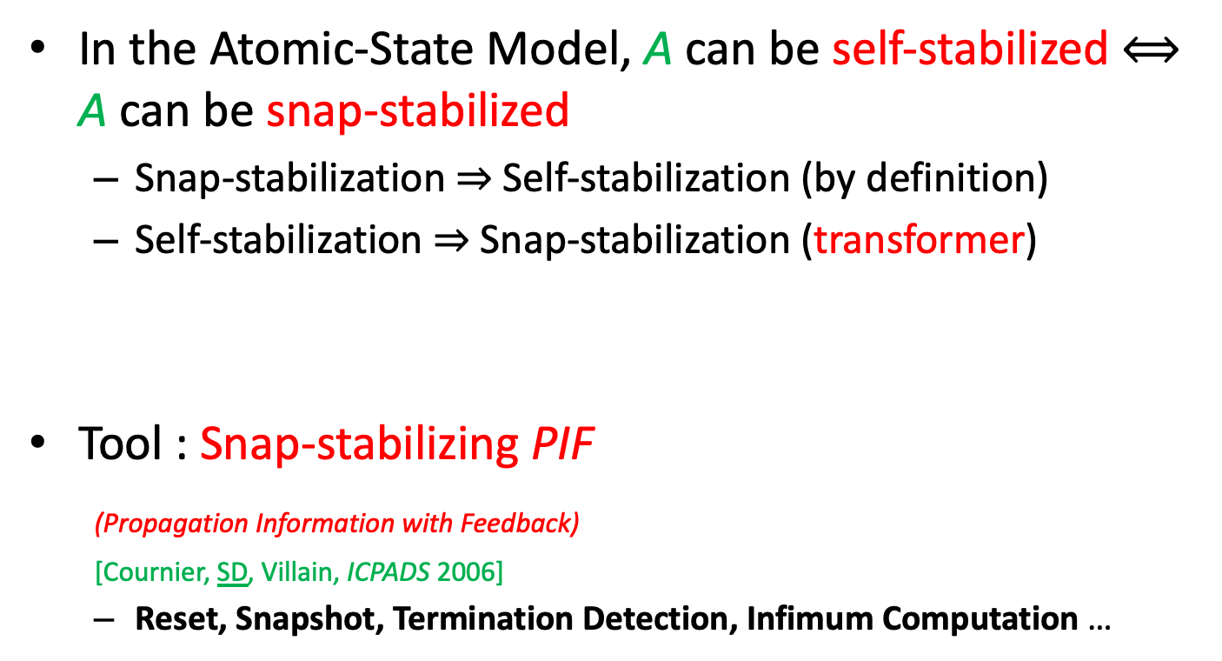
Transformers/Compilers
In the Atomic-State Model, A can be self-stabilized $⟺$ A can be snap-stabilized
  Snap-stabilization $⇒$ Self-stabilization (by definition)
  Self-stabilization $⇒$ Snap-stabilization (transformer)
Tool : Snap-stabilizing PIF
(Propagation Information with Feedback)
[Cournier, SD, Villain, ICPADS 2006]
  Reset, Snapshot, Termination Detection, Infimum Computation …
Feedback
Broadcast
Notes:
ASM:
- high-level model
- most commonly used model in the SS area
2 phases:
broadcast of some info
feedback where all processes acknowledge the receipt of the information to the initiator
transformer is actually a composition of all these basic tools

Slide 35
Roadmap
Efficiency in Self-stabilization
Versatility in Self-stabilization
Unifying Versatility and Efficiency in Self-stabilization
Detailed Example
Work in Progress and Perspectives
Notes:
20min40

Slide 36
Unifying Versatility and Efficiency in Self-stabilization
Reset-based approaches
  [Cournier, SD, Villain, TAAS 2009] and [SD, Johnen, ICDCS 2019]
Scheme for tree-based constructions
  [SD, Ilcinkas, Johnen, ICDCN 2019]
Local resource allocation problems
  [Altisen, SD, Durand, JPDC 2017] (Anaïs Durand’s PhD thesis)
Notes:
Here I quote few works where The goal was to provide efficient solutions not for a dedicated problem but rather to a wide class of problems
the first approach consists in designing and then carefully use an efficient reset algorithm
In the second approach we have identify common points between many problems close to tree construction. From these common points we have derived a general algorithm
whose instantiations are efficient
Finally, we have worked on efficient solutions for the class of local resource alloc problems

Slide 37
Local Resource Allocation Problems
LRA: generalization of local resource allocation problems [Cantarell, Datta, Petit, SSS 2003]
Based on a compatibility relation ⇋
X ⇋ Y:
  Resource types X and Y are compatible
  Two neighboring processes can access them concurrently

Slide 38



Examples
Local mutual exclusion
  1 Resource Type:
Local reader-writer
  2 Resource Types: ,
  ⇋ , ,
Many other examples: drinking philosophers, local group mutual exclusion, …

Slide 39
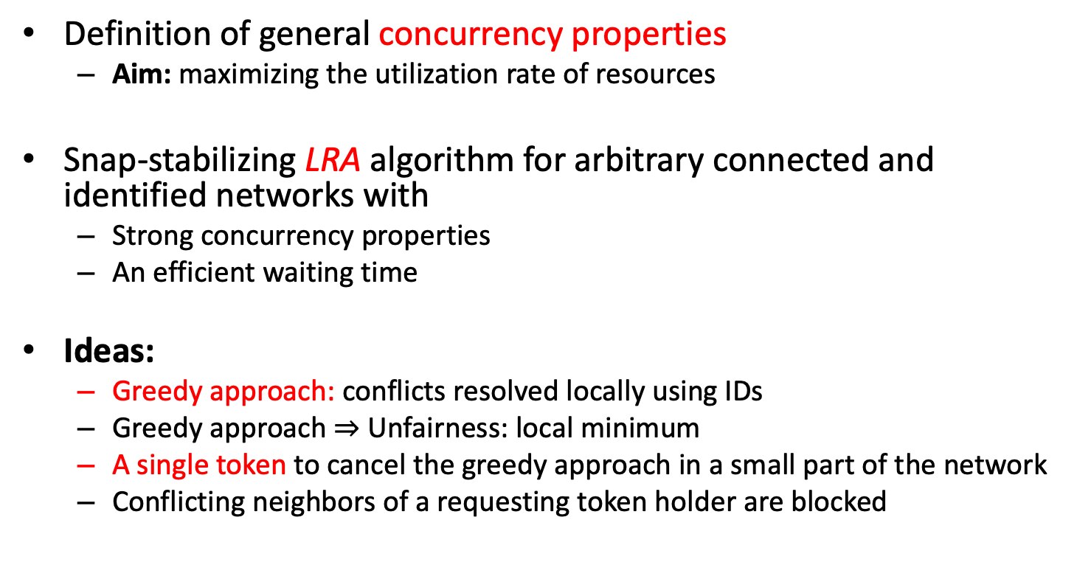
Contribution
Definition of general concurrency properties
  Aim: maximizing the utilization rate of resources
Snap-stabilizing LRA algorithm for arbitrary connected and identified networks with
  Strong concurrency properties
  An efficient waiting time
Ideas:
  Greedy approach: conflicts resolved locally using IDs
  Greedy approach $⇒$ Unfairness: local minimum
  A single token to cancel the greedy approach in a small part of the network
  Conflicting neighbors of a requesting token holder are blocked

Slide 40
Roadmap
Efficiency in Self-stabilization
Versatility in Self-stabilization
Unifying Versatility and Efficiency in Self-stabilization
Detailed Example
Work in Progress and Perspectives
Notes:
23min40

Slide 41
Snap-stabilization
A lot of solutions are available, but only in
  Identified, or
  Rooted networks
What about anonymous networks ?

Slide 42
Snap-stabilization in Anonymous Networks
Snap-stabilization ⇒ Self-stabilization
Most of classical problems, e.g.,
  Token passing
  Leader Election
  …
have no deterministic self-stabilizing solutions, and so no deterministic snap-stabilizing solutions
Notes:
strengthened form of self-stabilization

Slide 43
Probabilistic Snap-stabilization in Anonymous Networks
[Altisen, SD, TCS 2017]
Idea:
  Relaxing snap-stabilization without altering its strong safety guarantees
  to address anonymous networks
Weakened form of snap-stabilization
Not comparable to self-stabilization

Slide 44
Definition
For every task started after the faults
  The safety of the specification is satisfied
  The liveness of the specification is only almost surely ensured (Las Vegas approach)
Transient faults
The task is executed safely, but it terminates in almost surely finite time

Slide 45
Contribution
2 probabilistic snap-stabilizing protocols for
the guaranteed service leader election
for anonymous networks in the atomic-state model
  The first one assumes a synchronous scheduler
  The second one assumes an asynchronous scheduler
  This problem has no deterministic self- or snap- stabilizing solution

Slide 46
Definition of the problem
processes
P₁
P₂
P₃
P₄
P₅
time

Slide 47
Definition of the problem
processes
?
P₁
?
P₂
?
P₃
?
P₄
?
Upon a request
A process initiates the question
“Am I the leader of the network ?”
P₅
time

Slide 48
Definition of the problem
The task consists in computing the answer (yes/no)
processes
?
yes
P₁
?
no
P₂
?
no
P₃
?
no
P₄
?
no
P₅
time

Slide 49
Definition of the problem
Each process always receives the same answer to each of its request
processes
?
yes
?
yes
?
yes
P₁
?
no
?
no
P₂
?
no
?
no
P₃
?
no
?
no
P₄
?
no
?
no
?
no
P₅
time

Slide 50
Definition of the problem
Exactly one process always receives yes
processes
?
yes
?
yes
?
yes
P₁
?
no
?
no
P₂
?
no
?
no
P₃
?
no
?
no
P₄
?
no
?
no
?
no
P₅
time

Slide 51
Overview of the synchronous solution
Non-stabilizing probabilistic solution
Probabilistic self-stabilizing solution
Probabilistic snap-stabilizing solution

Slide 52
Required Knowledge
We assume that each process knows a value B s.t.:
  B < n ≤ 2B, where n is the number of processes
If processes have no global information about the network (e.g., its size), the problem is impossible to solve
Sketch: reduction to the Ring-Size Counting problem, which has no Las Vegas solution in anonymous networks

Slide 53
Solution in a fault-free synchronous system

Slide 54
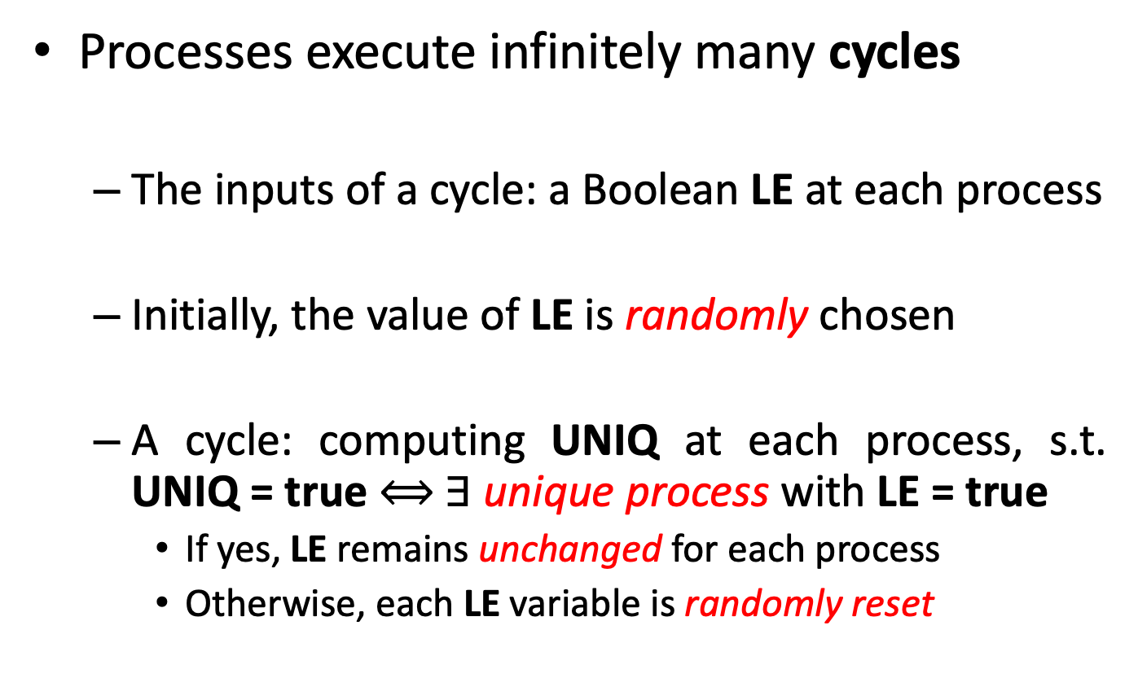
Cycles
Processes execute infinitely many cycles
  The inputs of a cycle: a Boolean LE at each process
  Initially, the value of LE is randomly chosen
  A cycle: computing UNIQ at each process, s.t. UNIQ = true $⟺$∃ unique process with LE = true
    If yes, LE remains unchanged for each process
    Otherwise, each LE variable is randomly reset

Slide 55
Request
Upon a request, a process waits the end of the cycle
  If UNIQ = true, then the value of LE is the answer
  Otherwise, the answer is delayed to (at least) the end of the next cycle
Aim: ensuring that there is a unique process with LE = true at the end of a cycle within almost surely finite time

Slide 56
How to compute a cycle?
Initially:
  The value of LE is randomly chosen by each process
  UNIQ is set to false
Each cycle is made of 3 phases
Each phase lasts 2B steps (2B > Diameter)
Each process has a local clock which takes value in [0..6B-1] to know in which phase it is
Notes:
allowing a computation involving all processes

Slide 57
How to compute a cycle?
First Phase: compute a spanning forest s.t.
  Each tree is rooted at a process such that LE = True
  If no such process: no tree at the end of the phase
F
F
F
F
T
F
F
F
T
Notes:
expliquer T/F

Slide 58
How to compute a cycle?
First Phase: compute a spanning forest s.t.
  Each tree is rooted at a process such that LE = True
  If no such process: no tree at the end of the phase
F
F
F
F
T
F
F
F
T

Slide 59
How to compute a cycle?
Second Phase: each root (if any) computes the number of nodes in its tree
1
2
1
F
F
F
3
6
1
F
T
F
1
1
3
F
F
T

Slide 60
How to compute a cycle?
  At the end of the phase
    If a root has more that B processes in its tree: LE ← True; UNIQ ← True
    Otherwise, processes execute: LE ← False; UNIQ ← False
  (Here, we choose B = 5)
Second Phase: Each root (if any) computes the number of node in its tree
F,1
F,2
F,1
F
F
F
F,3
T,6
F,1
F
T
F
F,1
F,1
F,3
F
F
F

Slide 61
How to compute a cycle?
  Remark: at most one process satisfies the 1st case since B ≥ n/2
Second Phase: Each root (if any) computes the number of node in its tree
F,1
F,2
F,1
F
F
F
F,3
T,6
F,1
F
T
F
F,1
F,1
F,3
F
F
F
Notes:
Hence there is at most one LE variable equal to true at the end of the phase

Slide 62
How to compute a cycle?
Third Phase: broadcast of the result
  Each process computes the disjunction of all UNIQ variables
T,1
T,2
T,1
F
F
F
T,3
T,6
T,1
F
T
F
T,1
T,1
T,3
F
F
F

Slide 63
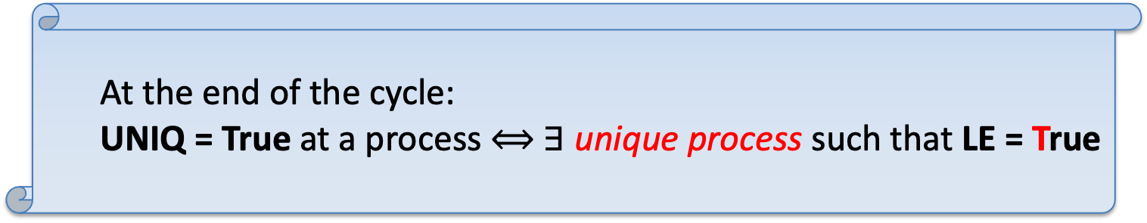
How to compute a cycle?
  At the end of the cycle:
  UNIQ = True at a process $⟺$ ∃ unique process such that LE = True
Third Phase: broadcast of the result
  Each process computes the disjunction of all the UNIQ variables
T,1
T,2
T,1
F
F
F
T,3
T,6
T,1
F
T
F
T,1
T,1
T,3
F
F
F

Slide 64

How to compute a cycle?
  At the end of the cycle:
  UNIQ = True at a process $⟺$ ∃ unique process such that LE = True
Third Phase: broadcast of the result
  Each process computes the disjunction of all the UNIQ variables
T,1
T,2
T,1
  At the beginning of the next cycle:
    LE is randomly reset if UNIQ = False
      W.p.p. a process will be elected in the next cycle
    Otherwise LE remains constant
    UNIQ is reset to false at each process
F
F
F
T,3
T,6
T,1
F
T
F
T,1
T,1
T,3
F
F
F

Slide 65
Complexity
The complexity depends on the law used to (re)set LE
Best choice: (re)set LE to true with probability p ∈ [1/2B,1/(B+1)]
In this case, the expected number of cycles to “stabilize” the value of LE is e²/2 (≤ 3.70)
The expected time to give an answer to a request is then in 0(n)

Slide 66
How to make this algorithm self-stabilizing?
After faults, processes can be desynchronized
Solution: a self-stabilizing synchronous unison
[Boulinier, Petit, Villain, PODC 2004]
  Clocks synchronize to the same value in at most 6B steps
  The first cycle started at 6B steps will correctly compute UNIQ!
Notes:
clocks are controlled by a sync unison algorithm

Slide 67
How to make this algorithm snap-stabilizing?
The first cycle after 6B steps correctly compute UNIQ
For each request
  Wait 6B steps (using a counter)
  Consider outputs of cycles started after these 6B steps
  Only outputs of correct cycles will be considered!
  The answer LE will be output only when UNIQ = true at the end of such a cycle
The expected delay for each answer remains in 0(n)

Slide 68
Roadmap
Efficiency in Self-stabilization
Versatility in Self-stabilization
Unifying Versatility and Efficiency in Self-stabilization
Detailed Example
Work in Progress and Perspectives
Notes:
39min50

Slide 69
Work in Progress and Perspectives
Toward More Uncertainty
  Self-stabilization in Homonymous Systems
  Self-stabilization in Highly Dynamic Networks
Toward More Efficiency
  Full Polynomiality
  Variants of Self-stabilization
Toward More Versatility
  Proof Labeling Schemes
  Computer-aided Techniques

Slide 70
Self-stabilization in Homonymous Systems
(Toward More Uncertainty)
Process identifiers not necessarily unique
  Model between anonymous and identified
  Practical justifications: group and ring signatures
Look for the limit of the determinism
Self-stabilization not addressed yet
Problem: symmetries

Slide 71
Self-stabilization in Highly Dynamic Networks
(Toward More Uncertainty)
The network topology evolves at a high frequency
  e.g., MANET, VANET, DTN, …
Ongoing work
  Preliminary results on leader election
  [Altisen, SD, Durand, Johnen, Petit, ICDCN 2021]
Dynamics modeled using Time-Varying Graphs or Evolving Graphs
  Taxonomy of classes
Studying expressiveness
  Basic tool: Propagation of Information with Feedback

Slide 72
Full Polynomiality
(Toward More Efficiency)
In the atomic-state model, 2 main time complexity measures: rounds and moves
  Trade-off problem
    Asymptotic round optimality (O(D))
    Move complexity polynomial on n
    Hard! [SD, Johnen, JPDC 2019]
  Full Polynomiality [Cournier, Rovedakis, Villain, Inf. & Cmp. 2019]
    O(D^{x}) rounds + O(n^{y}) moves
    Addressed in rooted networks
  Identified non-rooted networks?
  Expected full polynomiality in anonymous networks?

Slide 73
Variants of Self-stabilization
(Toward More Efficiency)
Weak versions: circumventing impossibility results
Strong versions: tightly capturing stronger fault tolerance skills
Mix of strong and weak variants
  e.g., FTPS [Delporte-Gallet, SD, Fauconnier, JPDC 2010], probabilistic snap-stabilization [Altisen, SD, TCS 2017]
  Lots of other possibilities to explore …

Slide 74
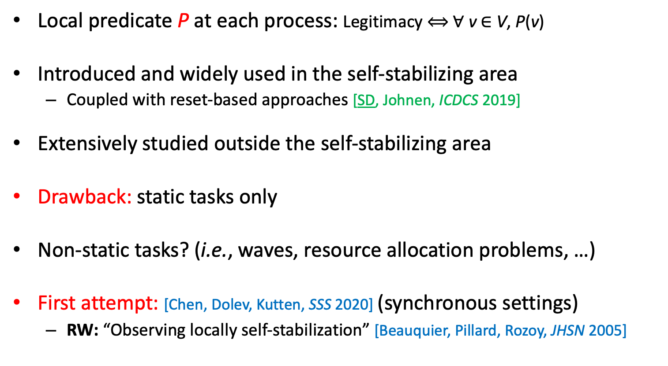
Proof Labeling Schemes
(Toward More Versatility)
Local predicate P at each process: Legitimacy $⟺$ $∀$v $∈$ V, P(v)
Introduced and widely used in the self-stabilizing area
  Coupled with reset-based approaches [SD, Johnen, ICDCS 2019]
Extensively studied outside the self-stabilizing area
Drawback: static tasks only
Non-static tasks? (i.e., waves, resource allocation problems, …)
First attempt: [Chen, Dolev, Kutten, SSS 2020] (synchronous settings)
  RW: “Observing locally self-stabilization” [Beauquier, Pillard, Rozoy, JHSN 2005]

Slide 75
Computer-aided Techniques
(Toward More Versatility)
Certification: mechanical checking using a proof assistant (Coq)
  Confidence on the result, remove useless assumptions
Library PADEC dedicated to self-stabilization (Project ESTATE)
  [Altisen, SD, Corbineau, LMCS, 2017], [Altisen, SD, Corbineau, FORTE 2019]
  Next steps:
    Certify classical proof patterns: induction, potential functions for algorithms; Indistinguishability, symmetries for impossibilities
    Highly dynamic systems (Post-doc M. Lesourd, 2021)
Other computer-aided tools
  Simulation: debugging, average complexity, … [Altisen, SD, Jahier, TAP 2020]
  Model-checking: impossibilities on small topologies [SD, Lamani, Petit, Raymond, Tixeuil, CJ 2021]

Slide 76
Thank you !
(in particular to my co-authors)

Slide 77


Slide 78
Overview of the asynchronous solution
We use the self-stabilizing asynchronous unison of [Boulinier, Petit, Villain, PODC 2004] to emulate synchronous executions of cycles.
  After stabilization, clocks differ from at most 1
Using this algorithm, cycles ``synchronize’’ in 8B rounds

Slide 79
Overview of the asynchronous solution
We use a result from [Boulinier, Levert, Petit, Villain, ICDCN 2008] to detect when cycles have stabilized:
  If the clock of some process successively takes values u, u+1, … u+(2D+1), with ∀ i ∈ {1, …, 2D+1}, u+i > 0, then every other process executes at least one step during that period.
Drawback: the expected delay for each answer is in 0(n²)

Slide 80
Composition Techniques
C = A o B
  Operator + sufficient condition for self-stabilization
Modular approach to simplify the design and the proofs
Very popular in self-stabilization

Slide 81
Composition Techniques
Hierarchical Collateral Composition
[Datta, SD, Heurtefeux, Larmore, Rivierre, ICNC 2013] (Yvan Rivierre’s PhD thesis)
  A and B run concurrently
  Locally A has the priority
Simple sufficient condition
  Certified in Coq [Altisen, Corbineau, SD, FORTE 2019]
Bounds on the stabilization time in rounds
Applied to various problems
  k-clustering [Datta, SD, Heurtefeux, Larmore, Rivierre, TCS 2016]
  l-exclusion [Carrier, Datta, SD, Larmore, ICDCN 2015]
  Ranking [Datta, SD, Larmore, Rivierre, TCS 2013]

Slide 82
Composition Techniques
Hierarchical Collateral Composition
[Datta, SD, Heurtefeux, Larmore, Rivierre, ICNC 2013] (Yvan Rivierre’s PhD thesis)
  Round Complexity only
  A o B: A should be silent
  (silent = local states eventually fixed)
More general sufficient condition (to include waves)
Move complexity

Slide 83
Generalization of the LRA paradigm
Weaknesses
  Not adapted to local versions of l-exclusion, k-out-of-l-exclusion, …
  (bounds on the number of resources or size of the requests)
Generalization to include “global” resource allocation problems?
  Solutions with strong concurrency properties, efficient waiting time, …
Should remain simple to be practical

Slide 84
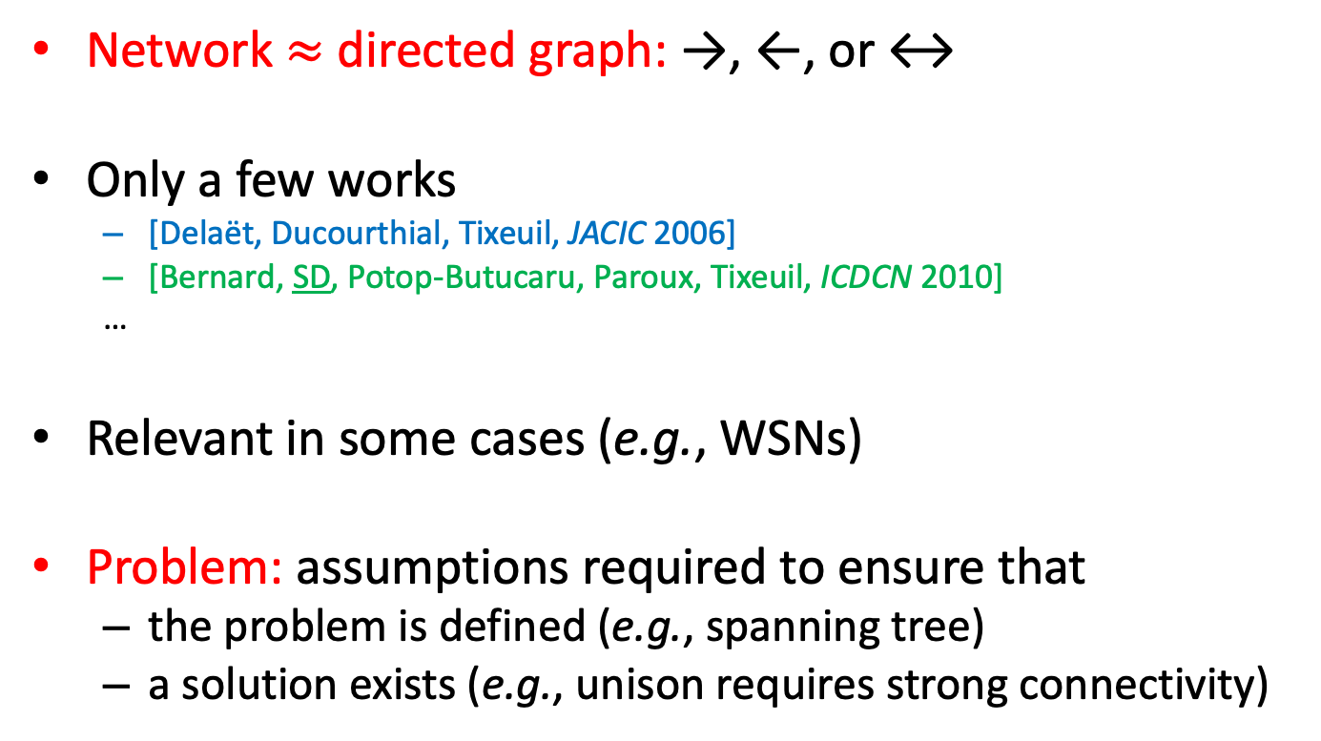
Self-stabilization in Unidirectional Networks
Network $≈$ directed graph: →, ←, or ↔
Only a few works
  [Delaët, Ducourthial, Tixeuil, JACIC 2006]
  [Bernard, SD, Potop-Butucaru, Paroux, Tixeuil, ICDCN 2010]
  …
Relevant in some cases (e.g., WSNs)
Problem: assumptions required to ensure that
  the problem is defined (e.g., spanning tree)
  a solution exists (e.g., unison requires strong connectivity)

