Slide 1
Toward a More Dependable Software Architecture for Autonomous Robots
Matthieu Gallien
DCS Days, Autrans

Slide 2
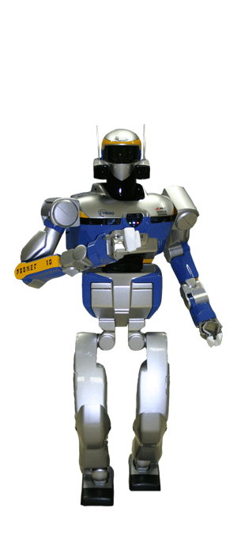
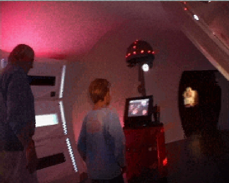
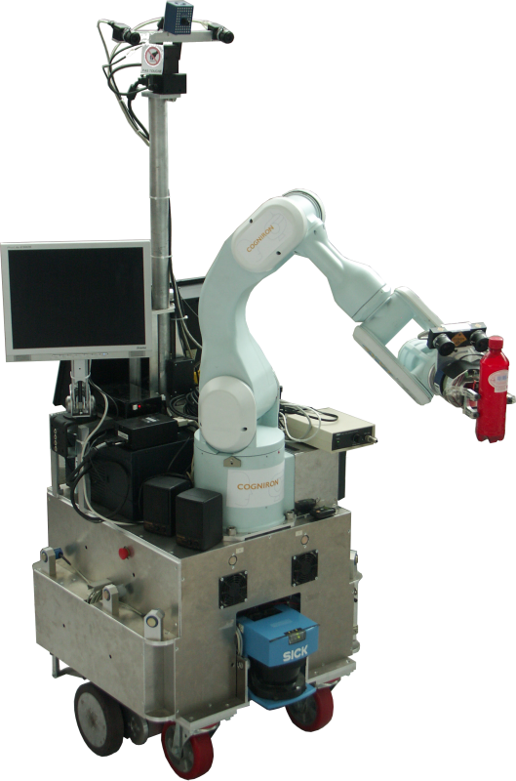
Introduction
Can we prove ?
that a nursebot will not move too quickly for an elderly person leaning on it
that your service robot is not going to open the gripper and drop the bottle of wine on the floor
Etc

Slide 3
Outline
A software architecture for autonomous robots
A component-based language and toolchain
Componentization of the robot software architecture
Verification results
Experimental results

Slide 4
LAAS Architecture for Autonomous Systems

Slide 5
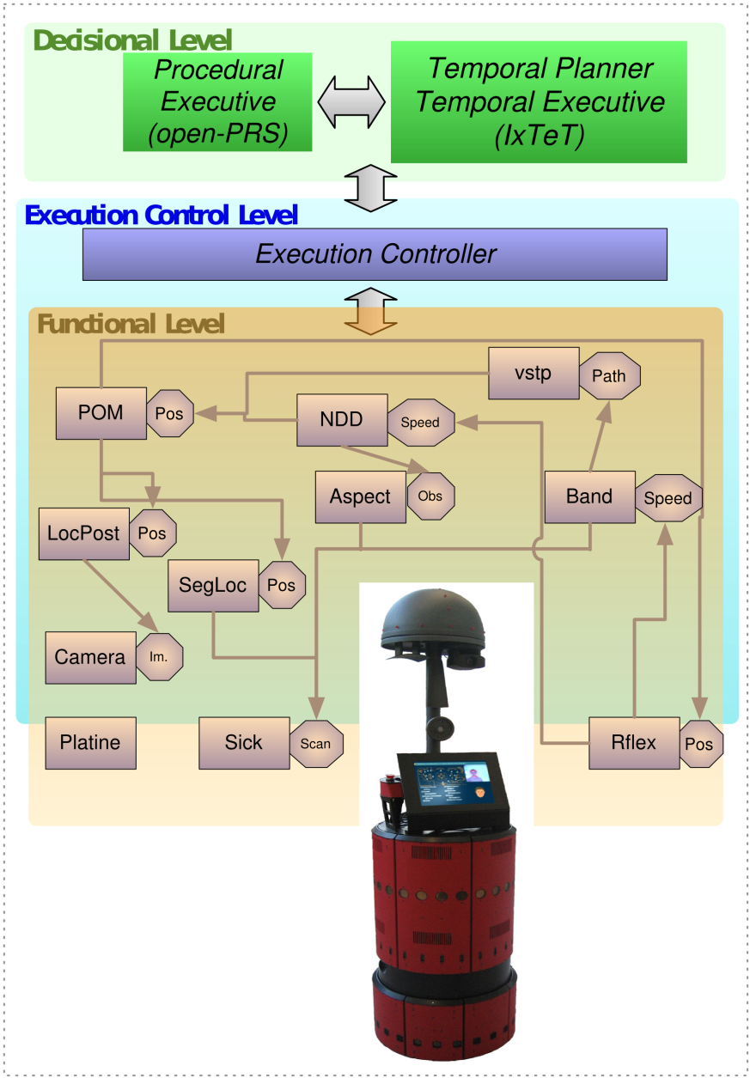
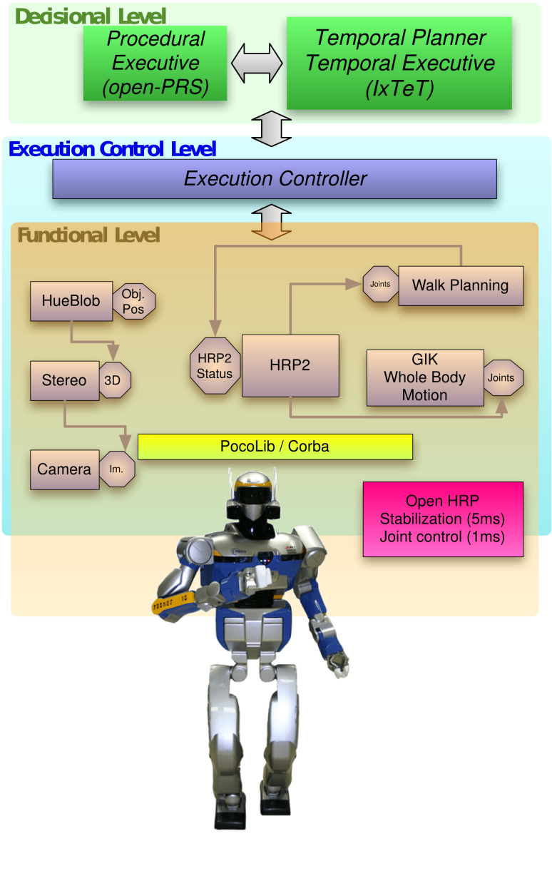
One Architecture/Multiple Robots

Slide 6
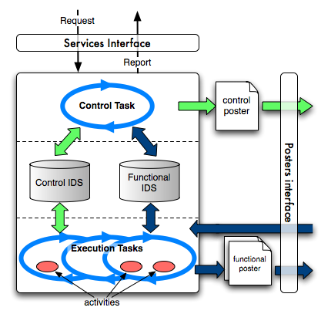
Functional Module

Slide 7
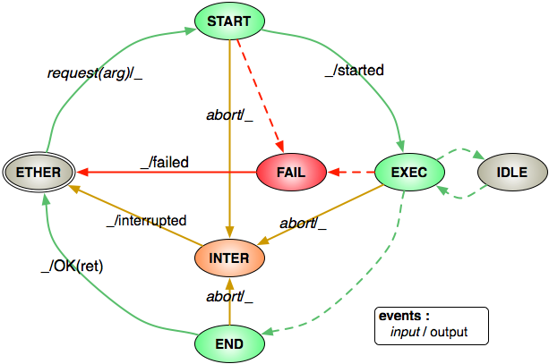
Execution Service
Generic model of an execution service
Based on classic thread life cycle
Executes the application code (codel)
Code is executed in the states
The next transition is decided by the executed code

Slide 8
Design Principle
Easing the development of software for the control of robots
Based on
Separation of reactive tasks from deliberative tasks:
Functional/ Decisionnal
Separation of control and data
The developer should never think about synchronization primitive
One function = One module
The developer should focus on algorithm implementation and not low level details

Slide 9
GenoM Workflow

Slide 10
Limitations
No model of the functional layer
only description of interface
No possibility of static analysis
Centralized controller has limitations (no time, own model, …)
Different representations or models between layers
Needs validation and verification

Slide 11
Using BIP (Behavior Interaction Priority)
Single model for controller and functional layer
Model that is verifyable and validable
Component-based approach
Allows to specify a distributed controller
Behavior of components can be
An automata or a Petri-net
Extended by external C code

Slide 12
The BIP Framework
Layered component model
Embedded Systems
Automotive
Avionics
Robotics
Mobile devices
Priorities
(Conflict resolution)
Interaction Model
(Collaboration)
B E H A V I O R
Composition (incremental description)
PR1
⊕
PR2
⊕
PR12
PR1
PR2
IM1
⊗
IM2
⊗
IM12
IM1
||
IM1
IM2

Slide 13
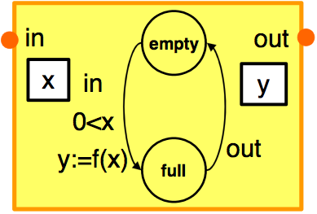
BIP: Behavior
An atomic component has
a set of ports P, for interaction with other comp.
a set of control states S
a set of variables V
a set of transitions of the form :
p is a port,
g is a guard, boolean expression on V,
f is a function on V (block of code)
p, g, f
s1
s2
Notes:
POint to the f(x) thing here. as a place holder for your code.

Slide 14
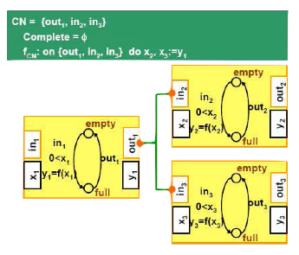
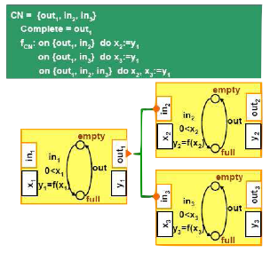
BIP : Interaction
A connector is a set of ports that can be involved in an interaction
Port attributes (complete, incomplete) are used to distinguish between broadcast and rendezvous

Slide 15
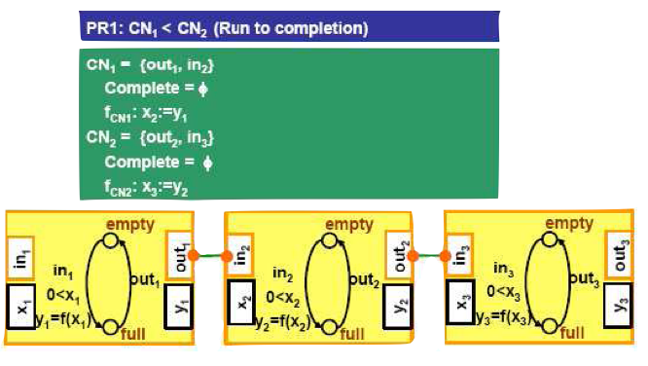
BIP : Priorities
When 2 interactions are possible, we fire first the one with the highest priority

Slide 16
Componentization Method
Follow as close as possible the GenoM behavior
Reuse all application code from GenoM
Separate the control from the code execution
Be compatible with the other layer of the architecture
Follow componentization method:
First identify by top-down approach what are the needed components
Second identify methods to build a system by combining the atomic components and adding connectors in a bottom-up approach

Slide 17
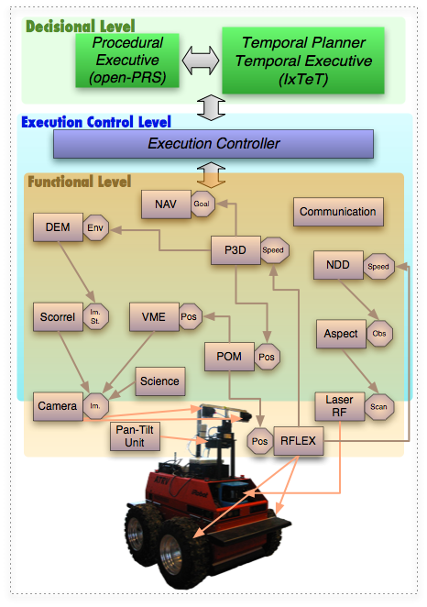
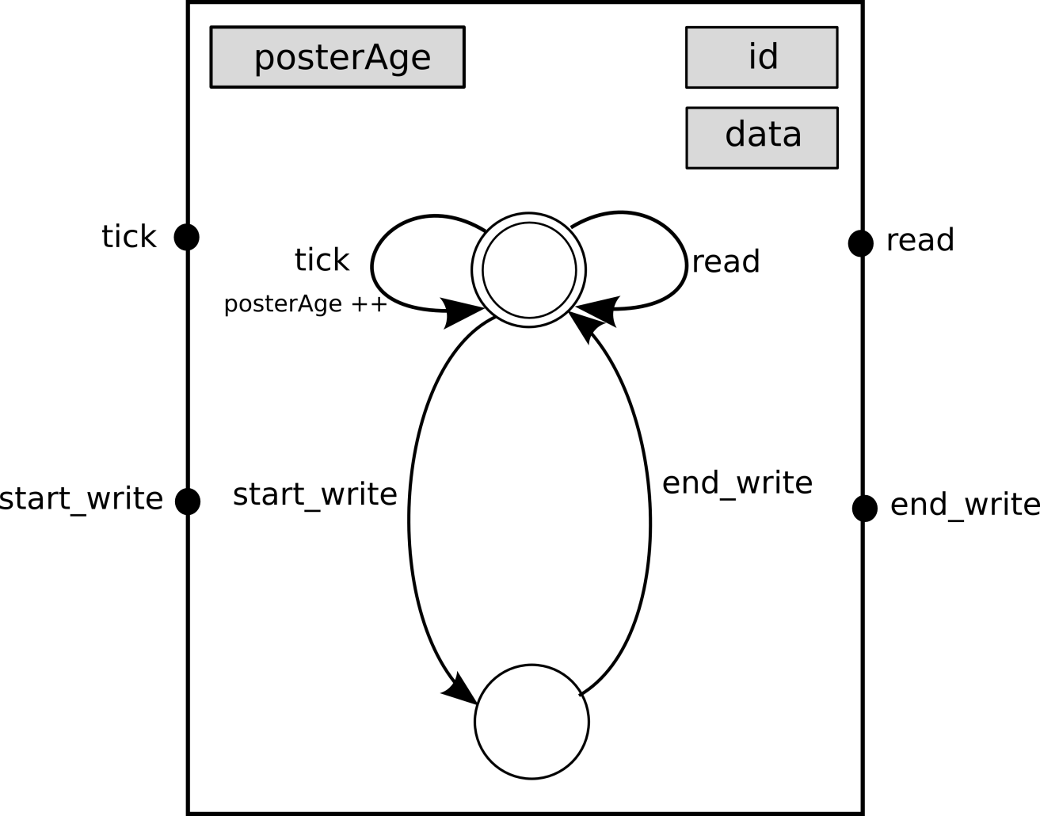
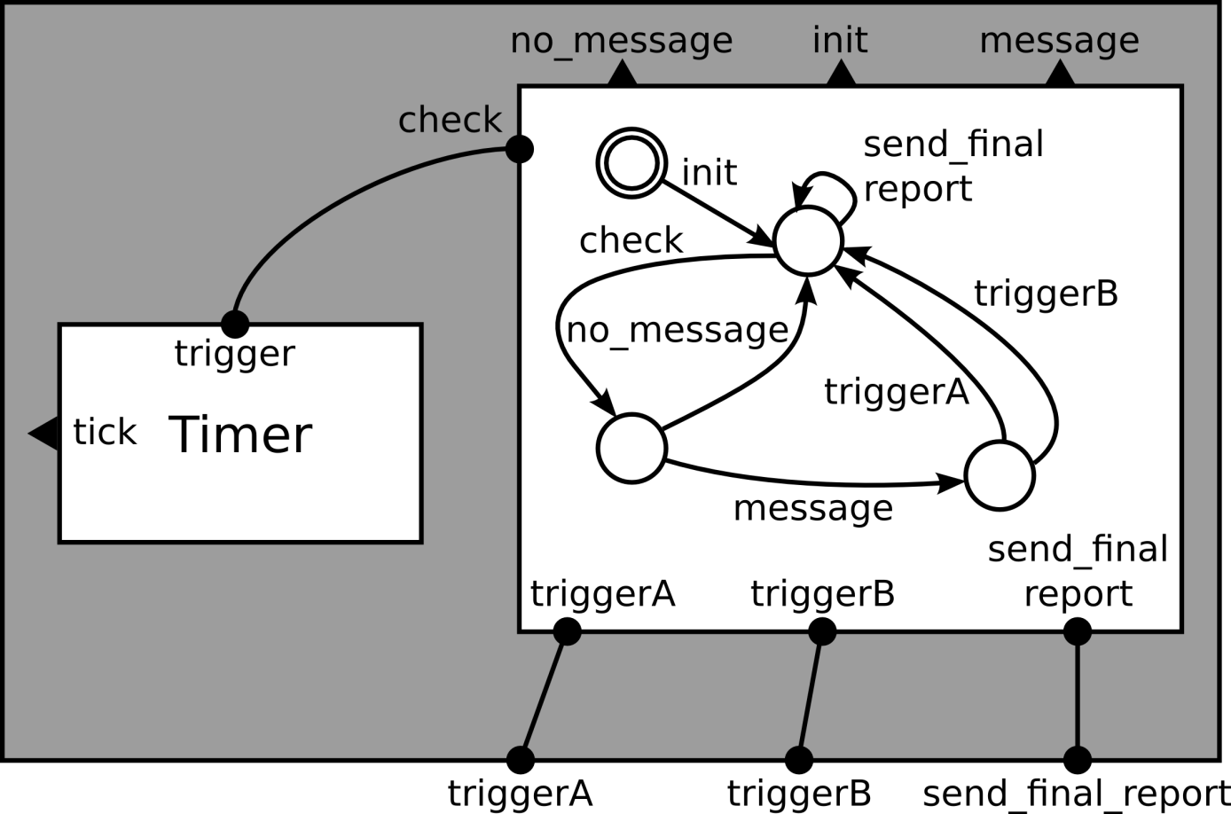
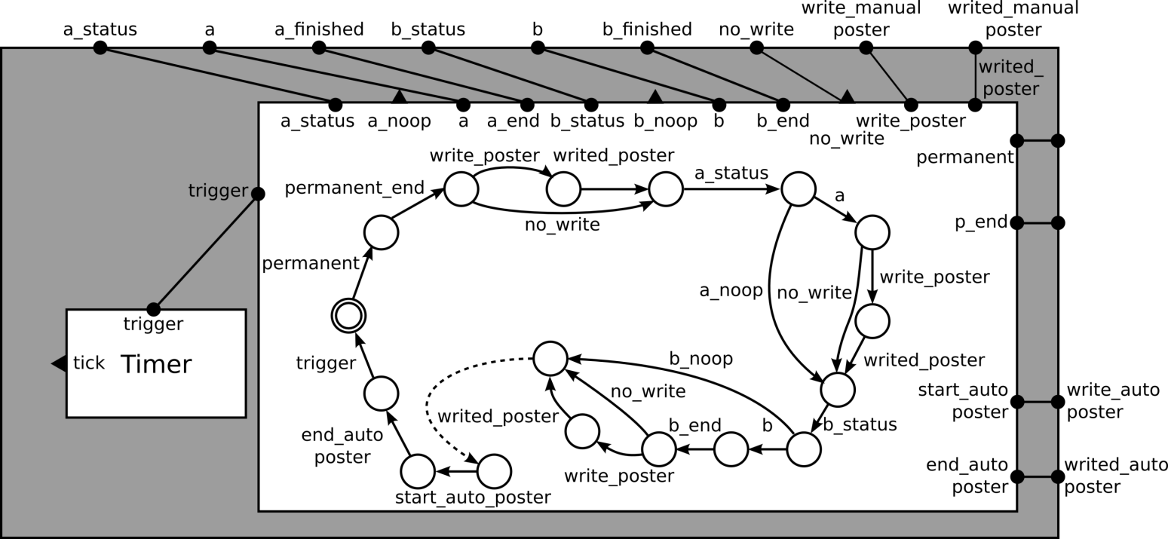
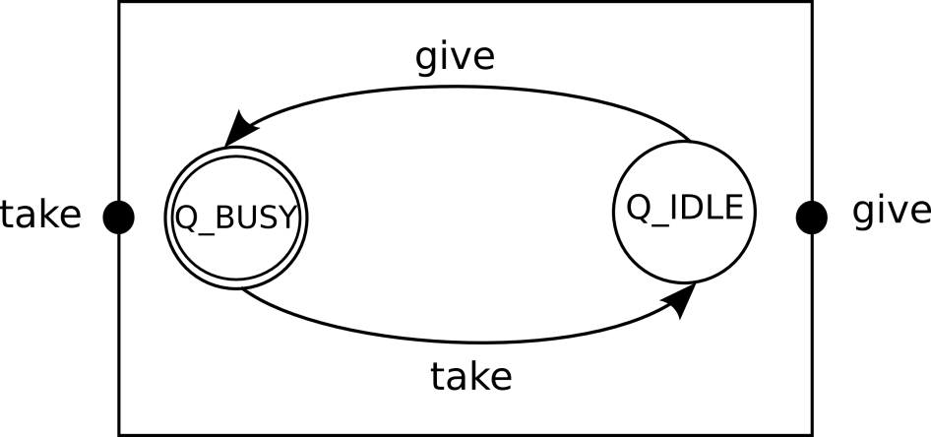
How to Decompose this into Components ?
LAAS Architecture::=Decisional Level.Execution Controller.Functional Level
Functional Level::=(Module)+
Module::=(Service)+ . (Execution task)+ . (Poster)+.MsgBox Interface

Slide 18
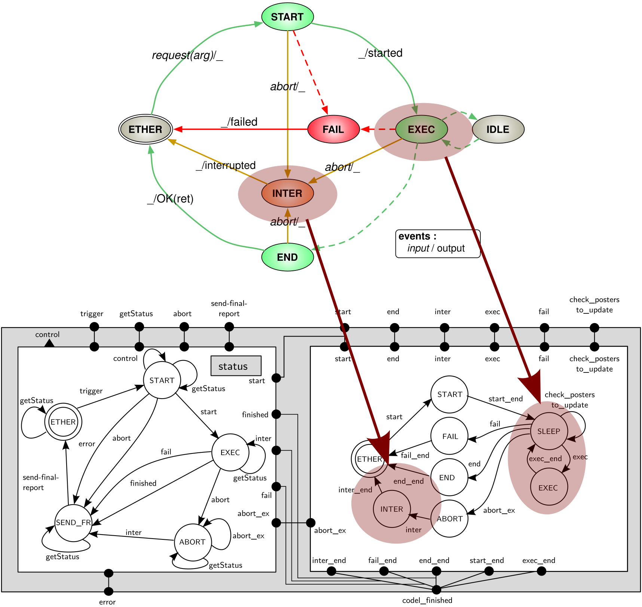
GenoM Service
Service::=Controller.Activity

Slide 19
BIP Model: Execution Task
Execution Task::=Timer.Scheduler

Slide 20
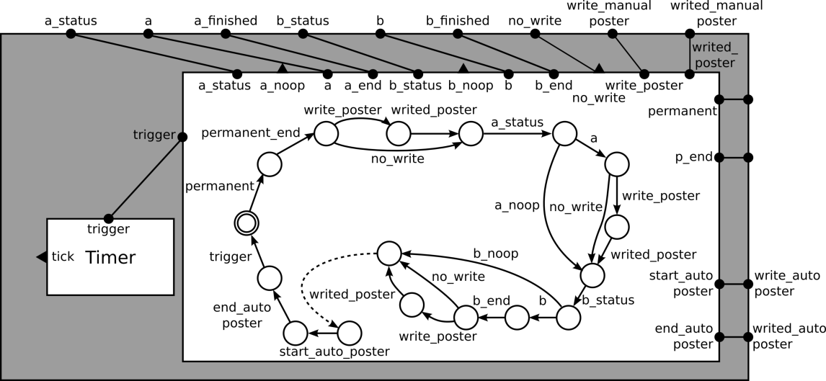
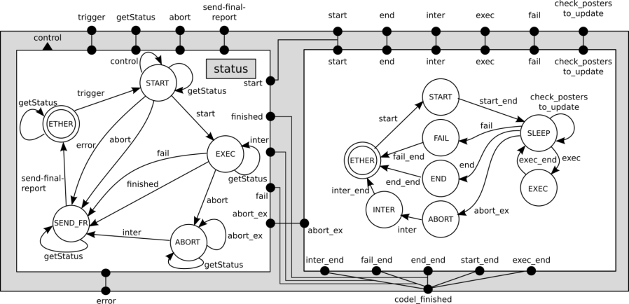
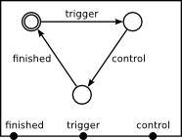
How to build a Functional Level
Module
Module
Module
Functional Level
Module
Module

Slide 21
Semi-Automatic Translation from GenoM to BIP
Generate BIP models from GenoM module descriptions
Generate C code needed to implement legacy interfaces to the module
Allow for seamless integration in the LAAS architecture
Needs manual modification of the C code libraries in order to have all synchronizations in the BIP model

Slide 22
Summary of Implementation
Works with the distributed BIP engine
GenoM generates one process for each module
Necessary to rely on the operating system to do fine grained interleaving
Simulate clocks with sleep (i.e. call to the operating system)

Slide 23
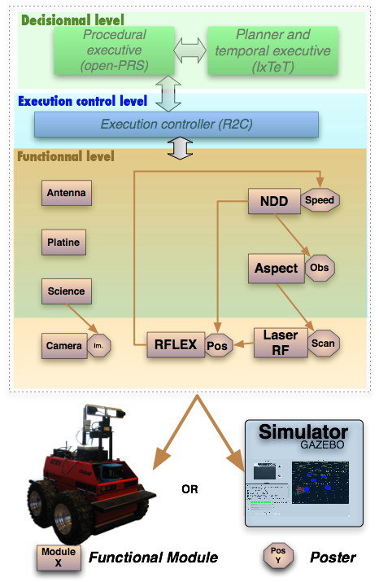
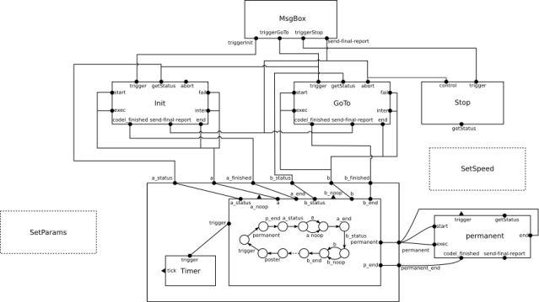
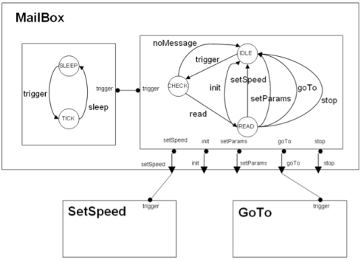
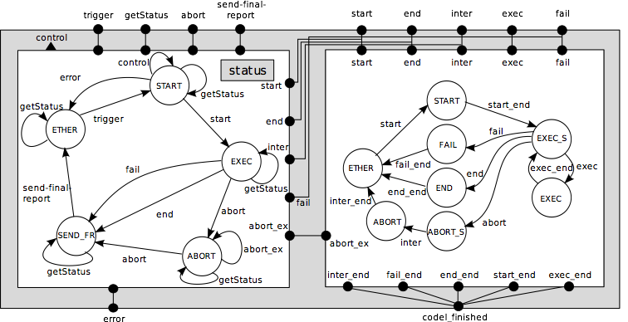
GenoM - BIP Toolchain
module Motion {
number: 9600;
SDI: MOTION_DATA;
}
request SetPos {
type: control;
input: pos::pos;
control: controlPos;
report: BAD_PARAM;
}
task Move {
period: 25;
priority: 15;
}
GenoM
Models
+
BIP
BIP
Controller
BIP
Controller
BIP
Controller
Codels
+
V&V
D-Finder
Aldebaran
etc
BIP Models

Slide 24
D-Finder
Can analyse BIP models without computing the reachable states;
Uses invariants to approximate the reachable states
Used to verify properties like the deadlock freedom on BIP models of the LAAS architecture
Deadlock freedom of the NDD module: 3 hours to detect the lack of deadlock
Discovered problems in the models that could cause deadlocks during execution

Slide 25
Encoding Constraints in the BIP model
One example: Data freshness
If a service needs data, it needs up-to-date data
GenoM translates this into « Poster reads »
Adding constraints into the BIP model to forbid reading an outdated poster

Slide 26
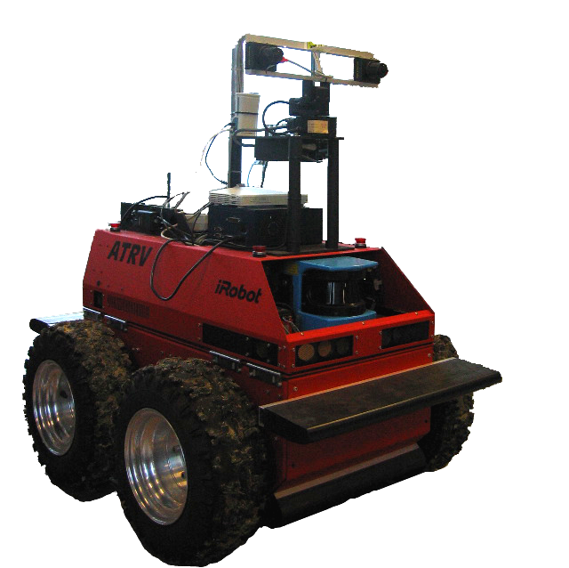
Experimental Results
Functional layer of Dala Robot is 8 modules
Complete navigation loop (4 modules) is modeled and generated with BIP
4 modules are still generated with GenoM
Except the functional layer, nothing change
Test with the real robot and a simulator
Test in normal condition and also with faults

Slide 27
Experimental Results
3 videos
Demonstrate normal behavior with BIP
Demonstrate that GenoM by itself cannot avoid faults or can contain bugs
Demonstrate that the controller resulting of the constraints and the BIP execution engine is safer

Slide 28
Normal Run with BIP

Slide 29
Faulty Run with GenoM

Slide 30
Fault Avoided with BIP

Slide 31
Conclusion
Development of a methodology to componentize the Functional Level of the LAAS Architecture
Development of a tool that produces BIP models from GenoM modules
Preliminary results about the verification and validation of the BIP models
Preliminary results about adding desired constraints into the BIP model

Slide 32
BIP Model: Full module

Slide 33
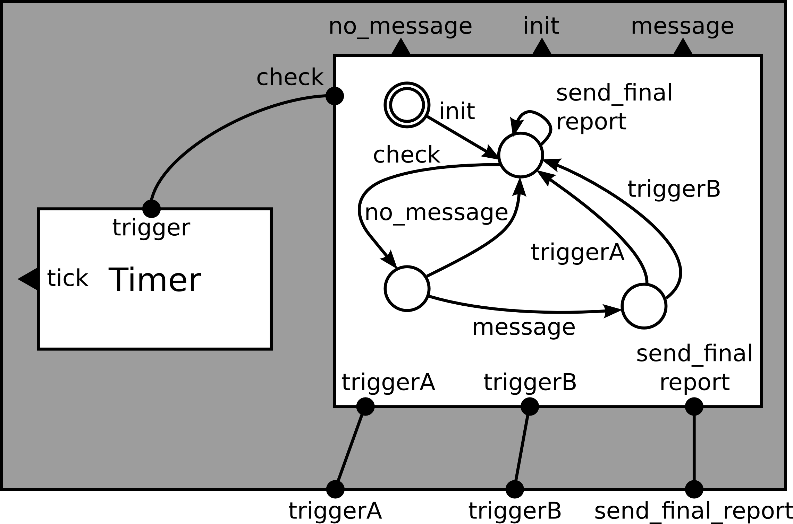
BIP models
Control
Service
MsgBox Interface
MsgBox Interface::=Timer.MsgBox Client

Slide 34
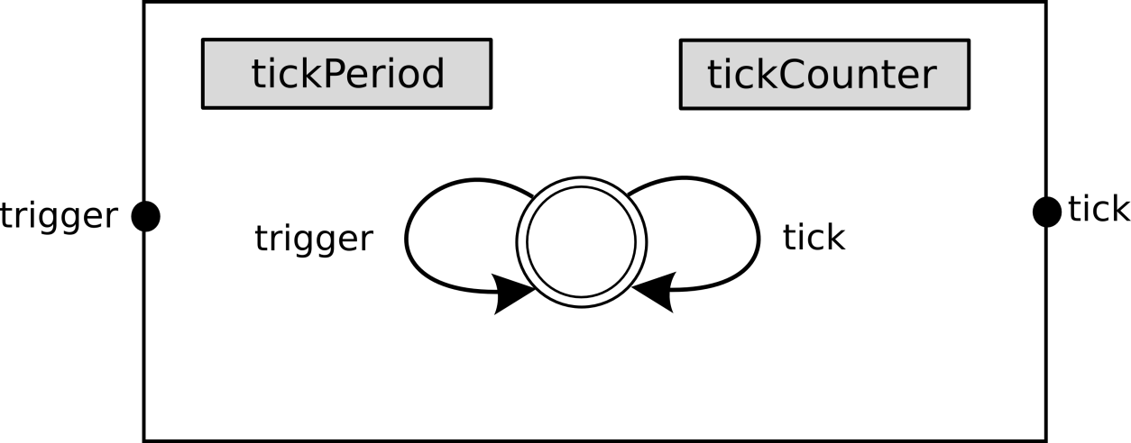
BIP Models
Poster
SDI Lock
Timer

Slide 35
Atomic Components
Timer
SDI lock
Poster
Control Service
Execution Service Controller
Execution Service Activity
Scheduler

